Slide 1
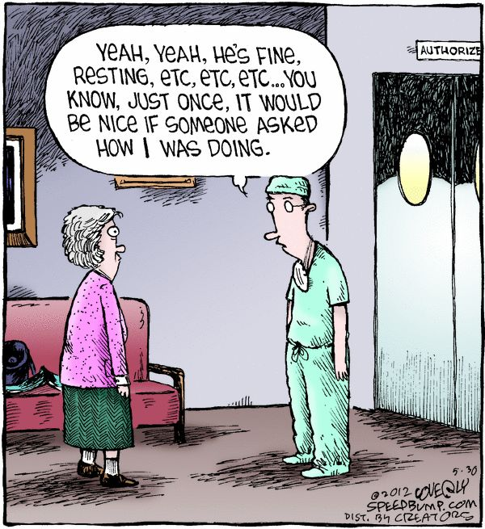
How Do You Feel? Taking Care of Yourself, While Taking Care of Others
Jessi Gold, MD MS (@drjessigold)
Chief Wellness Officer, University of Tennessee System
Associate Professor, Dept. of Psychiatry, University of Tennessee Health Science Center
Marshall University, Joan C. Edwards School of Medicine

Slide 2
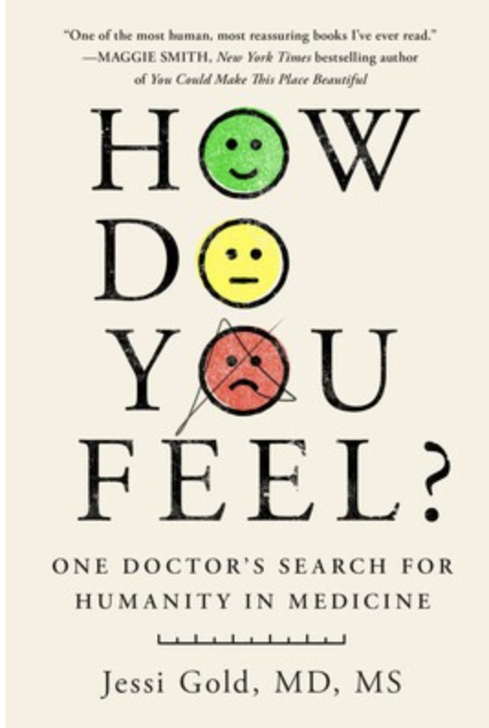
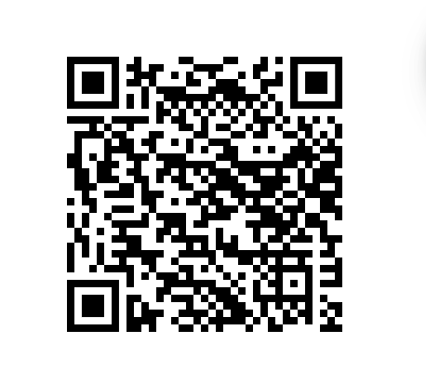
Disclosures
Ineligible Companies: None
FYI: Commercial/Consulting relationships
  Mental health storytelling consultant, MTV Entertainment Studios
  Mental Health Council, Rare Beauty

Slide 3
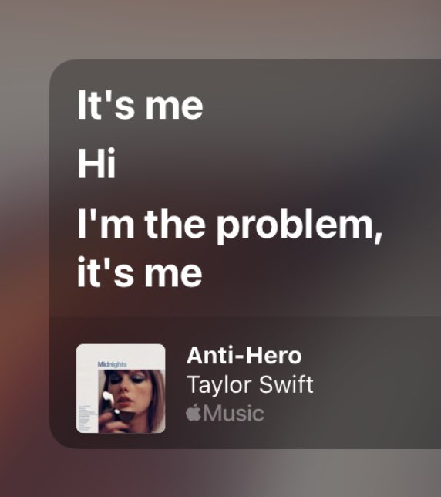
Disclosures
My perspective is my own, and doesn’t represent the university. It also represents that of my own identities (white, female)
I use humor (often through pop culture and silly cartoons) as a defense mechanism, but also to break up an otherwise hard topic
This information can sometimes be triggering of your experience, whatever you are feeling is OK, Including rage at me for having this conversation and the way I choose to have it

Slide 4

1 University System | 5 Campuses, 2 Statewide Institutes
62K+
STUDENTS STATEWIDE
14K
GRADUATES / YEAR
454K+
ALUMNI WORLDWIDE
19K+
FACULTY & STAFF

Slide 5
Objectives
Define burnout in healthcare and the impact of COVID-19
Describe the culture of healthcare and how it prevents help seeking for mental health needs
Discuss strategies individuals and teams can use to cope with burnout

Slide 6
Question:
How Do You Feel?

Slide 7
Fine.
OK.

Slide 8
Why?
The work/patients comes first. It’s not “about me.”
No one else is reacting. I don’t want to stand out.
I need to be perfect. Emotions get in the way.
Good doctors are stoic and “resilient."

Slide 9
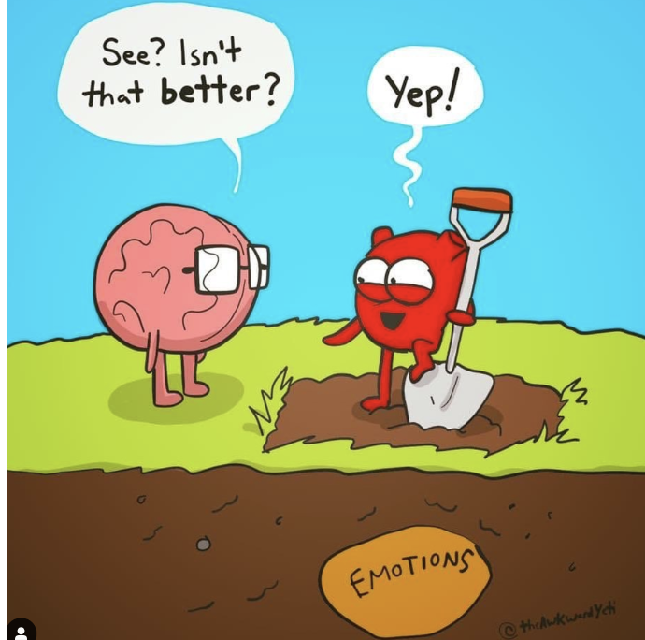
In Other Words

Slide 10
But, There Is Another Reason…
We Might Not Even Realize We’re Not OK
Let Me Tell You My Story

Slide 11
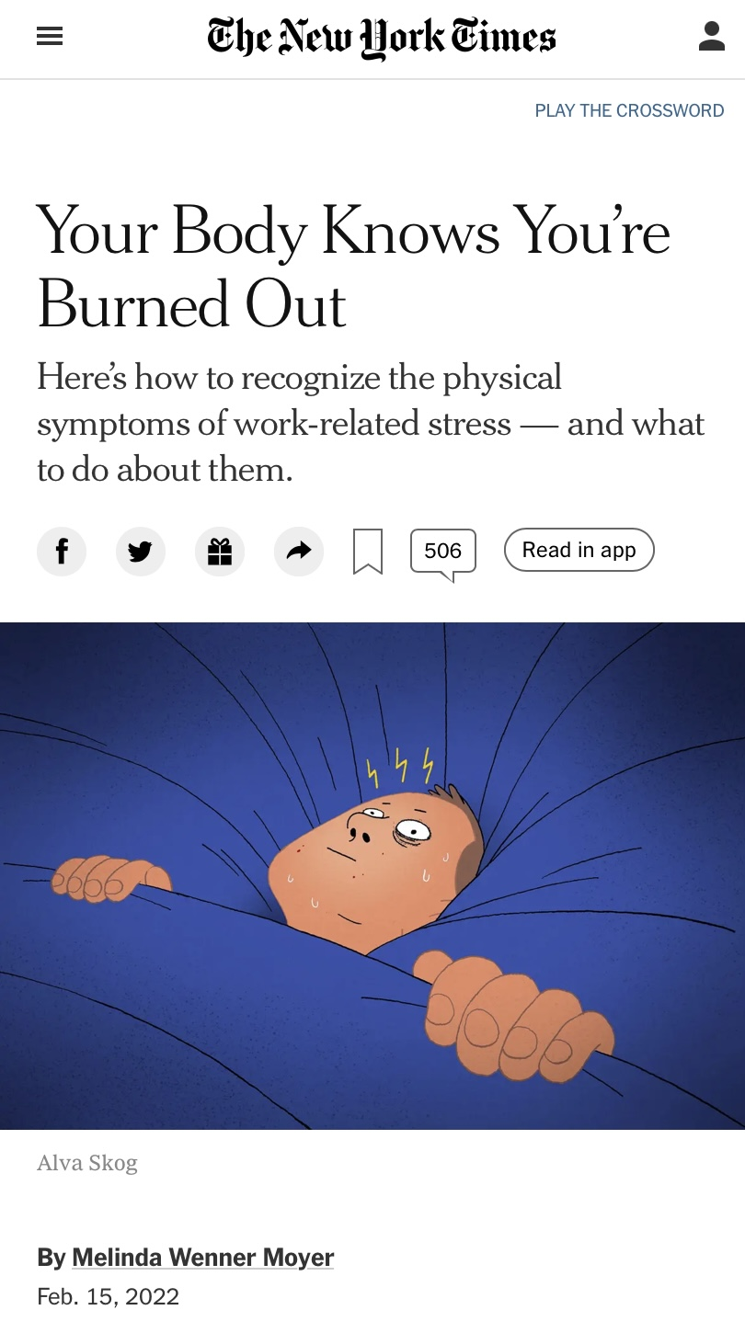
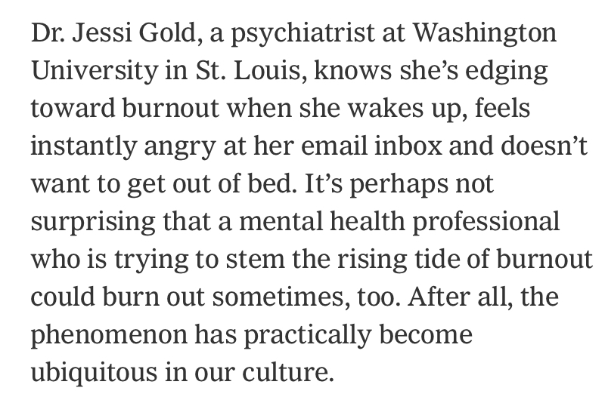
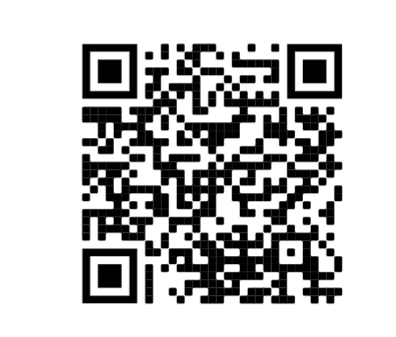

Slide 12
The “I Didn’t Know I Was Burned Out” Cycle
Step 1: Ignore symptoms until they are interfering with functioning
  AND tell patients they are OBVIOUSLY burned out and validate THEIR experiences

Slide 13
Burnout
Emotional exhaustion
AND Depersonalization
AND A sense of reduced personal accomplishment
Often is a mismatch between expectations of work and actual experience
Rates near or exceeding 50% have been documented in trainees and practicing physicians
  Compared to US working adults, physicians more likely burned out (Shanafelt et al, 2012)

Slide 14
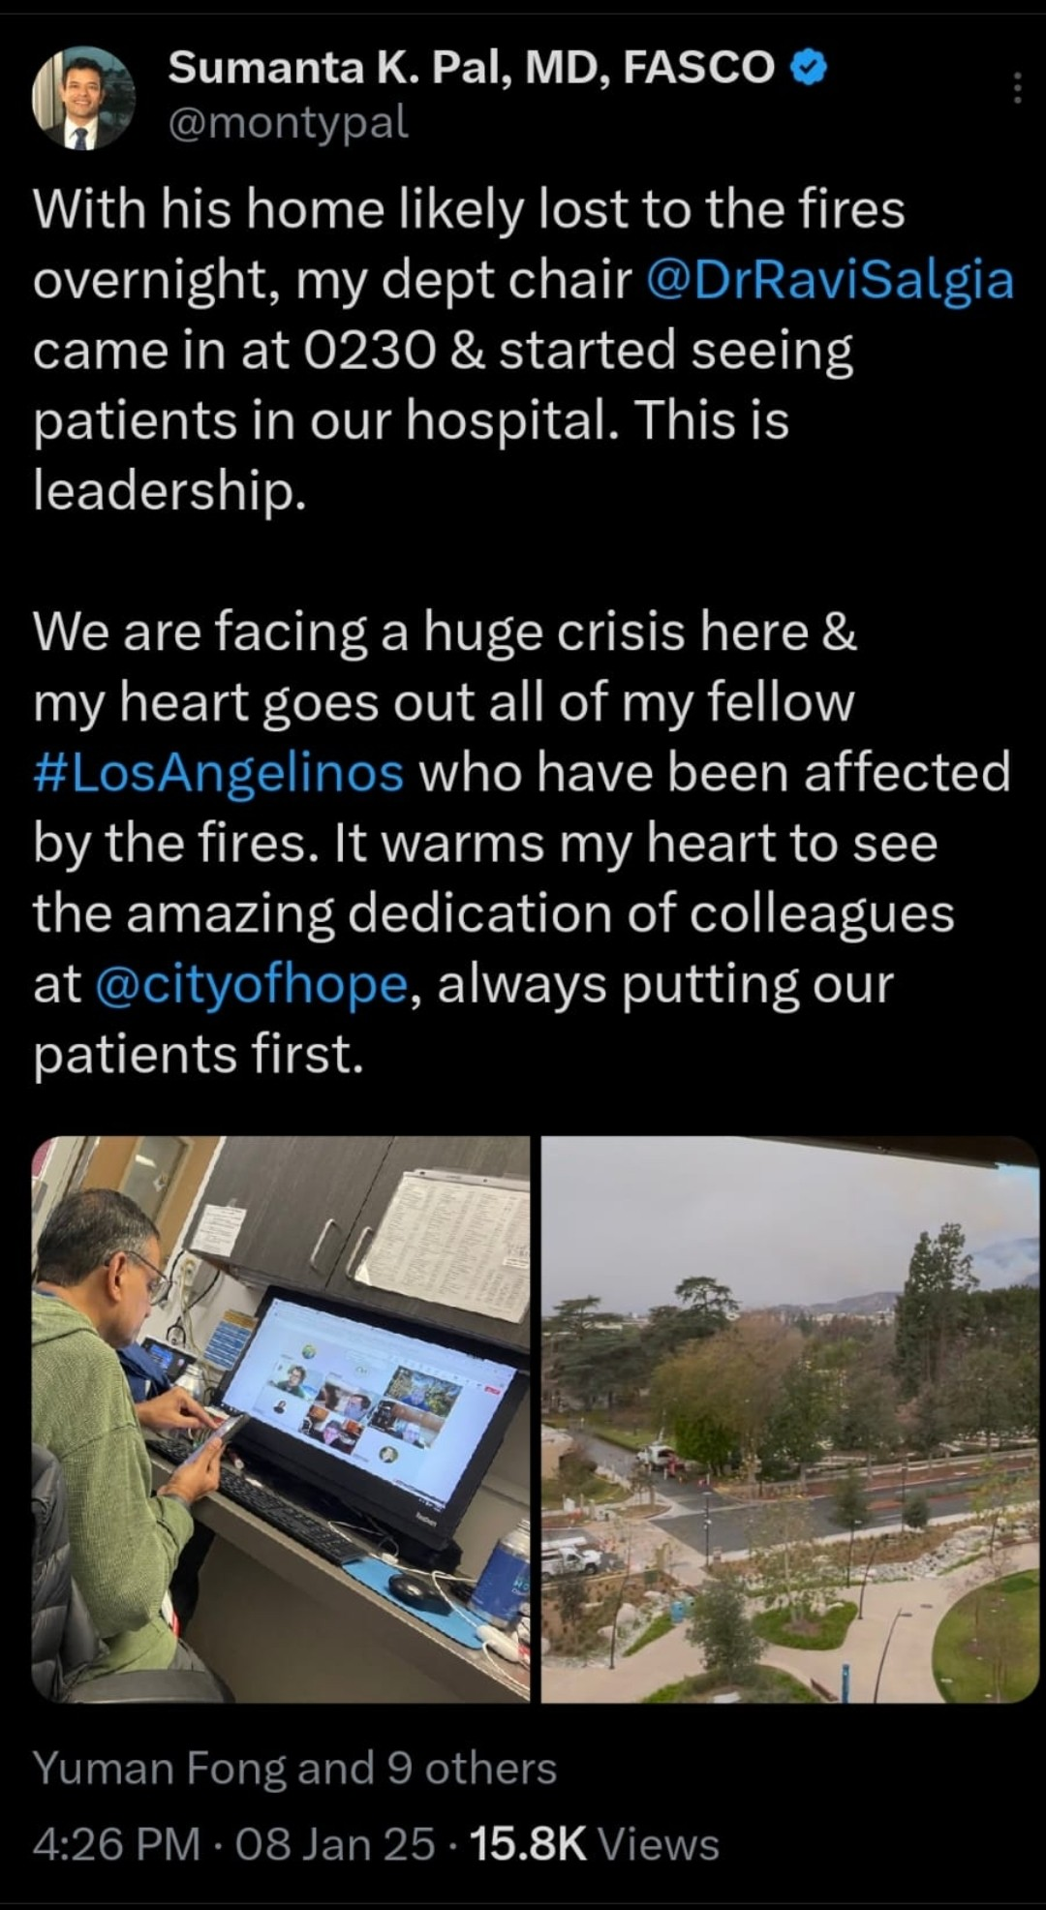
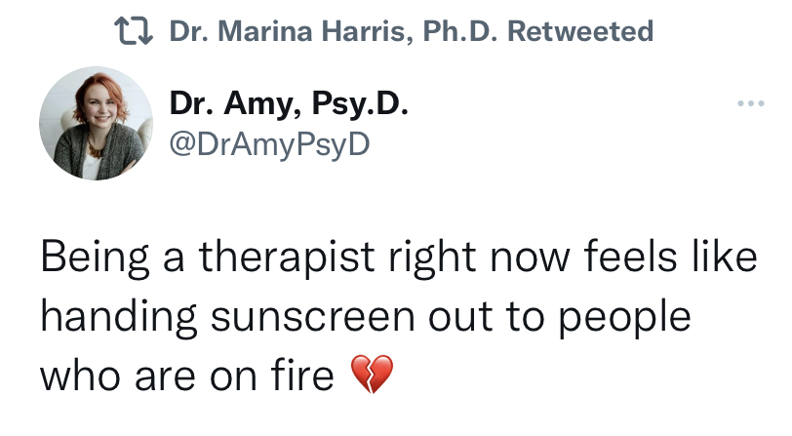
The “I Didn’t Know I Was Burned Out” Cycle
Step 2: Try to blame it on work being hard

Slide 15
Logical Scapegoat:
We Don’t Even Know We Need Help
275 surgeons with a Well-Being Index score in the bottom 30% relative to national physician norms
  71% believed that their well-being was at or above average
Cannot reliably calibrate distress relative to colleagues
Severe distress is normal, or experience limited by inner circle and their experiences
Shanafelt et al, 2014

Slide 16
The “I Didn’t Know I Was Burned Out” Cycle
Step 3: Try to blame it on physical illness (B12 for me!)
Step 4: Assume a day off or two will help=Quick Fix
Step 5: Have someone else (my therapist!) say what is wrong with me
Then, Repeat (Too many times to count)

Slide 17
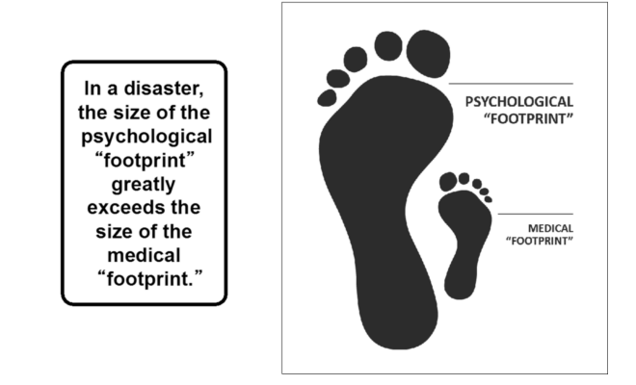
Keep in Mind COVID-19: The Great Compounder
Shultz, J. M., Espinola, M., Rechkemmer, A., Cohen, M. A., & Espinel, Z. (2016). 21 Prevention of Disaster Impact and Outcome Cascades.

Slide 18
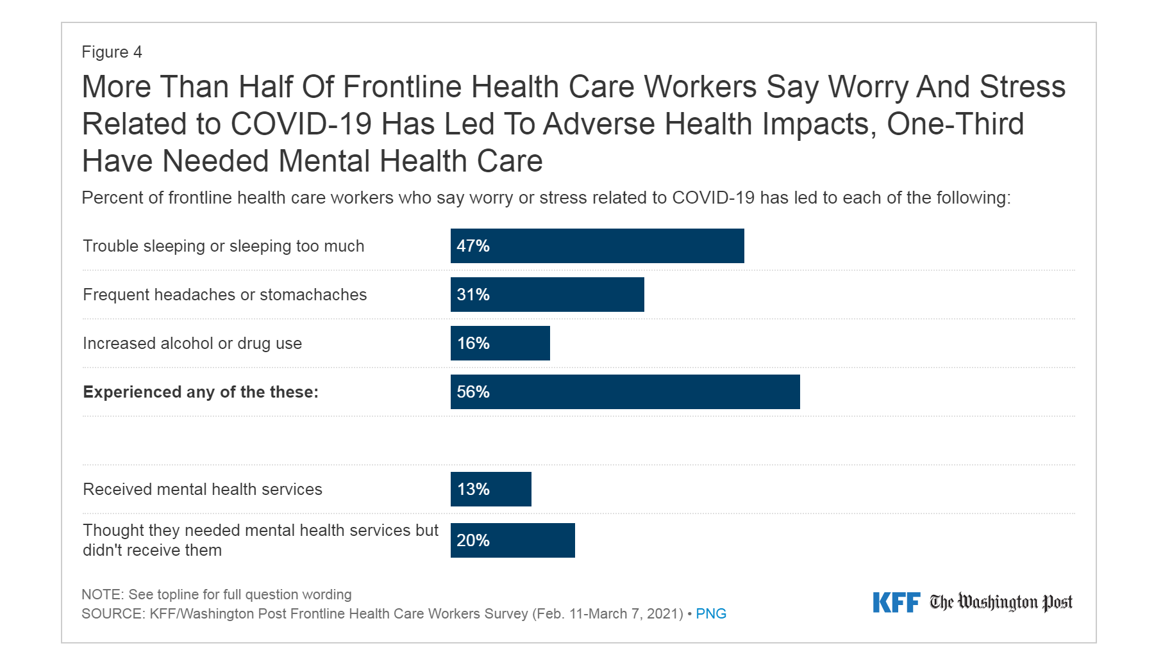
Still, We Don’t Get Help When We Need It
https://www.kff.org/report-section/kff-the-washington-post-frontline-health-care-workers-survey-toll-of-the-pandemic/?utm_campaign=KFF-2021-polling-surveys&utm_medium=email&_hsmi=2&_hsenc=p2ANqtz-_tlxawH1g2o0eCulRtjXwxQumTIiA3kgbSqd_2yCVKxIh7CTEUedmtKqn2lK--Ps-SfMpz8F5LmJuMC8Va2Yzt6P1VCA&utm_content=2&utm_source=hs_email
Most common reasons: Too busy (27%), Afraid or embarrassed about seeking care (17%), Couldn’t afford it (16%), or Couldn’t get time off work (14%).

Slide 19
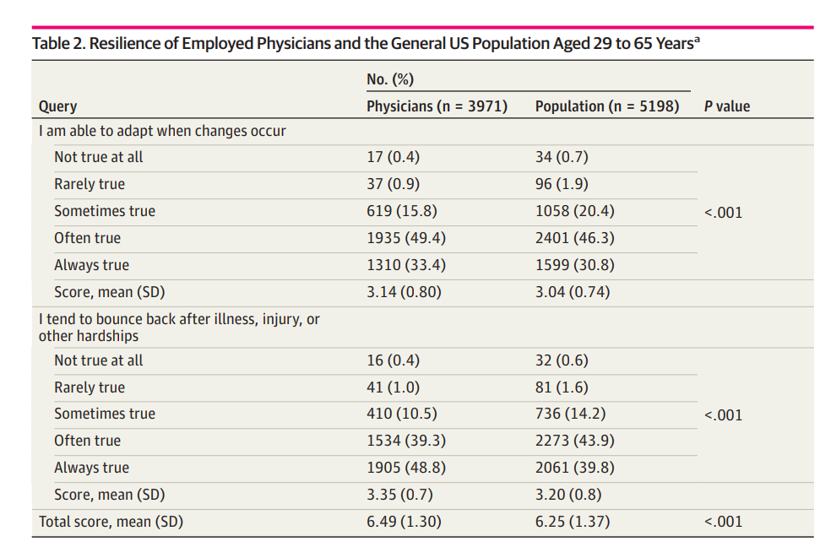
Fact: It is NOT about “Resilience”
Resilience > in physicians than the general working population
Burnout common even among physicians with the highest possible resilience score
  Even the most resilient physicians are at substantial risk of burnout!!!
West et al, 2020

Slide 20
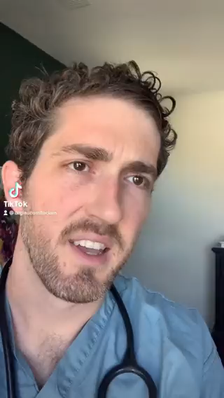
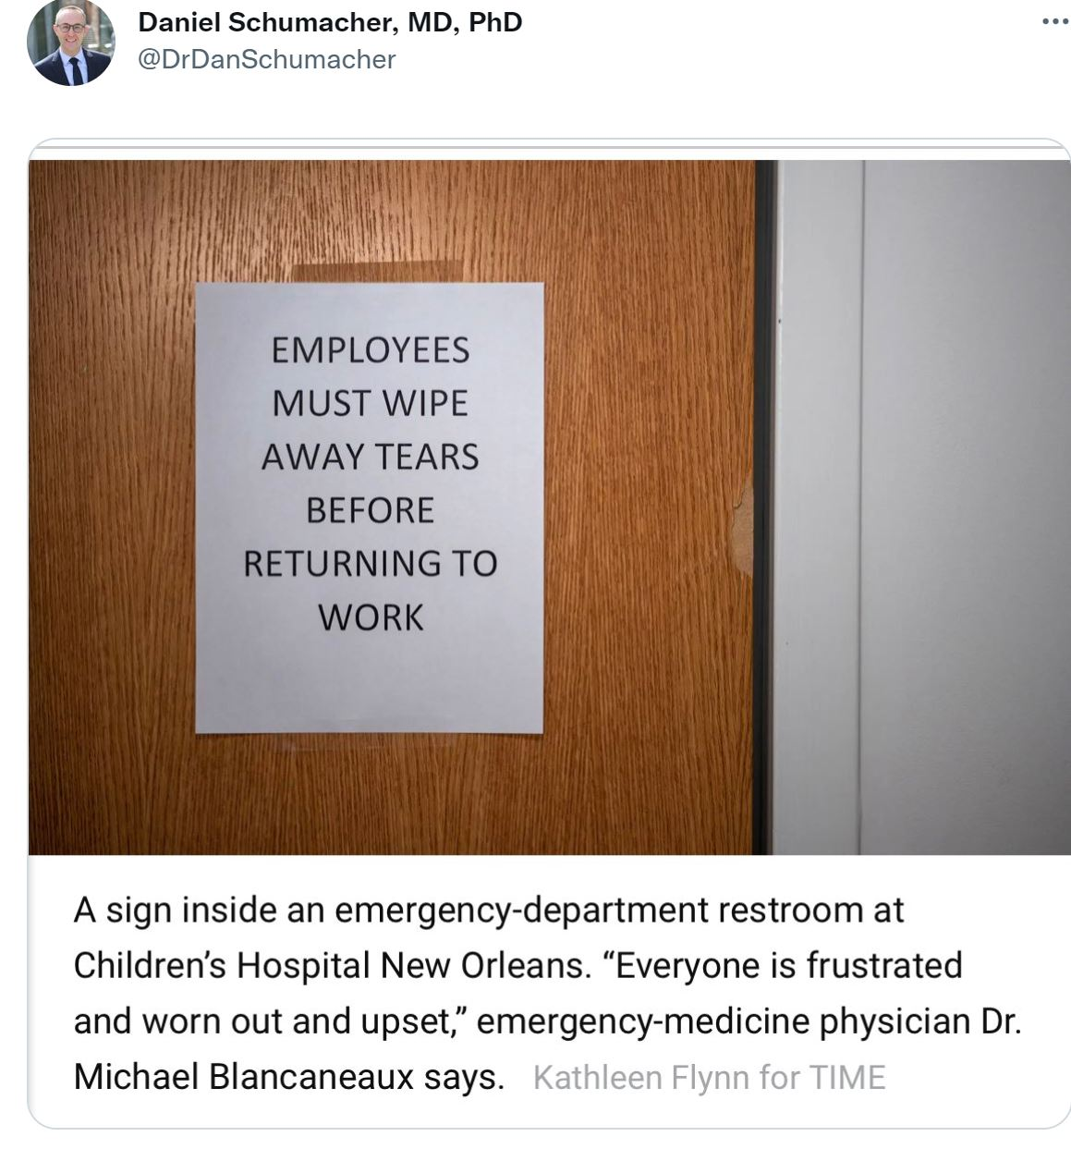
Spotlight: Medical Culture

Slide 21
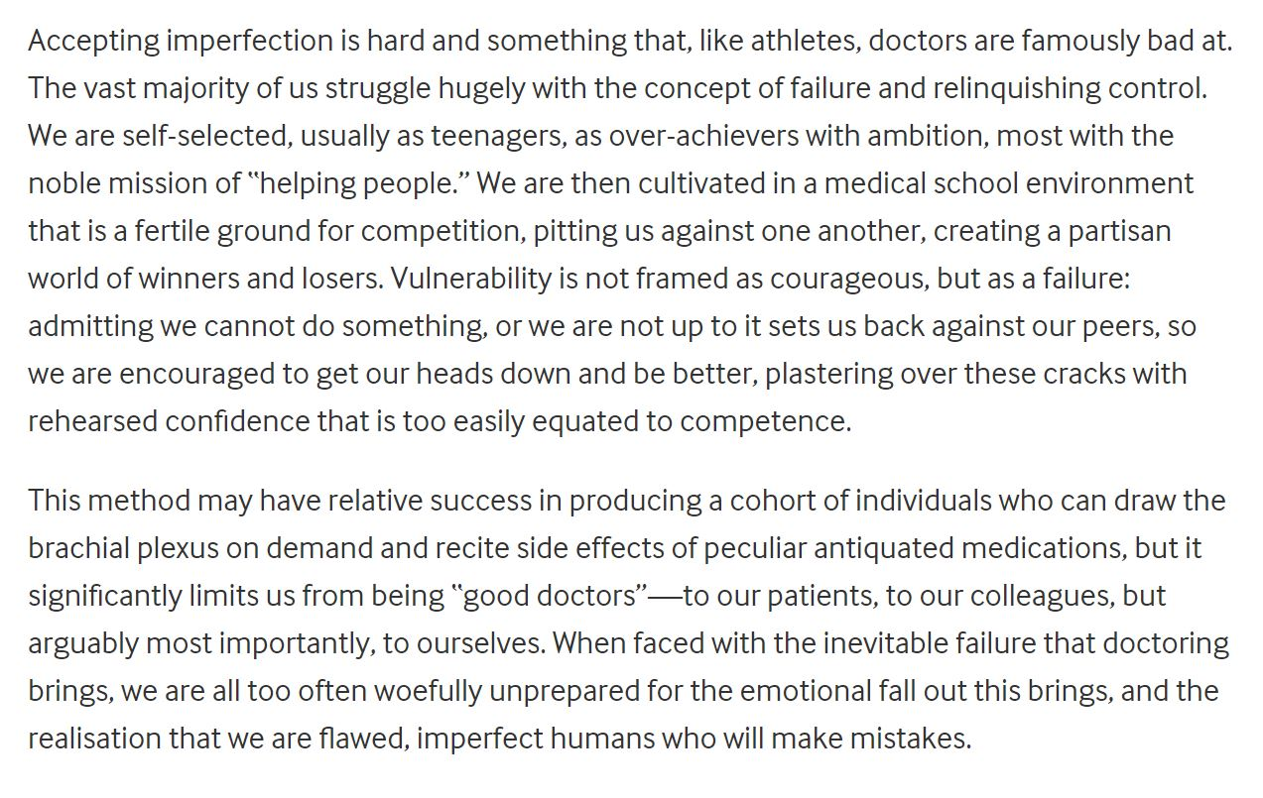
Munro, BMJ, 2021

Slide 22
Self-Valuation
N=832 physicians
29.8%: When make a mistake they “often” or “always” felt more self-condemnation than self-encouragement to learn from the experience
  50% higher than the proportion of workers in other fields
Adjusting for differences in self-valuation, the increased risk for burnout is no longer observed
  Lower self-valuation may be an explanatory variable in understanding medical culture and practice factors associated with physician burnout
Trockel et al, 2021

Slide 23
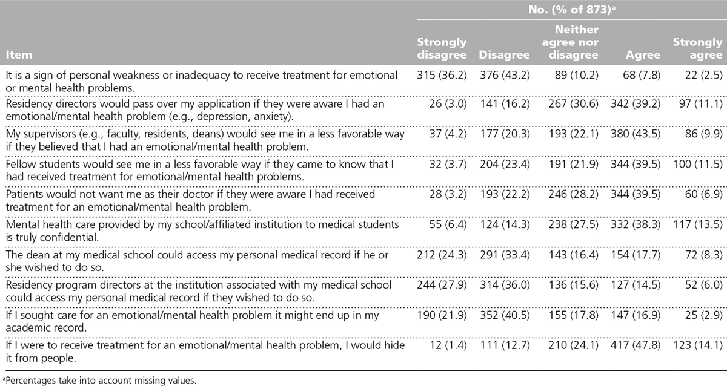
Medical Student Perspective of Culture
Dyrbye et al, 2015, Academic Medicine

Slide 24
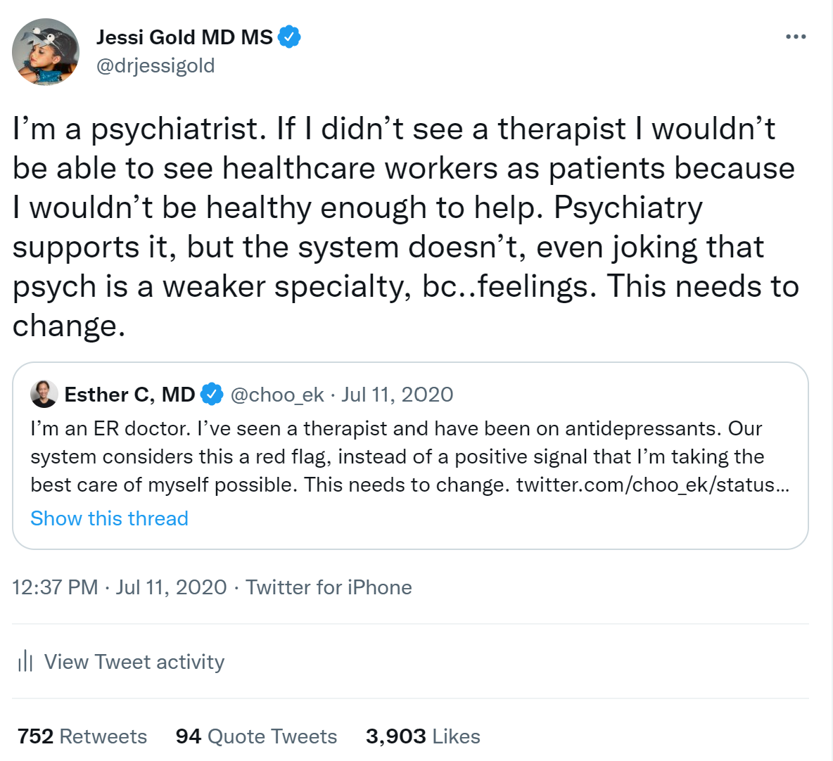
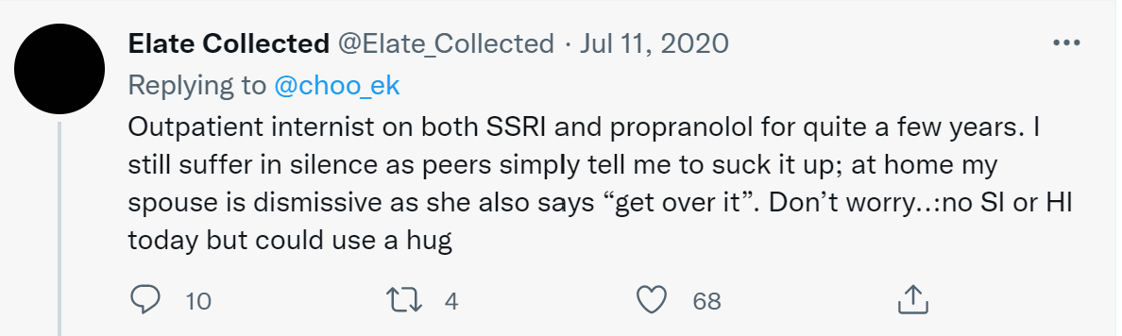
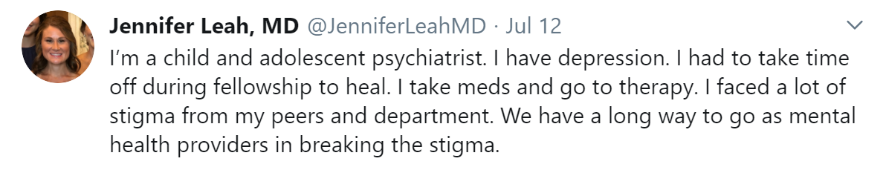
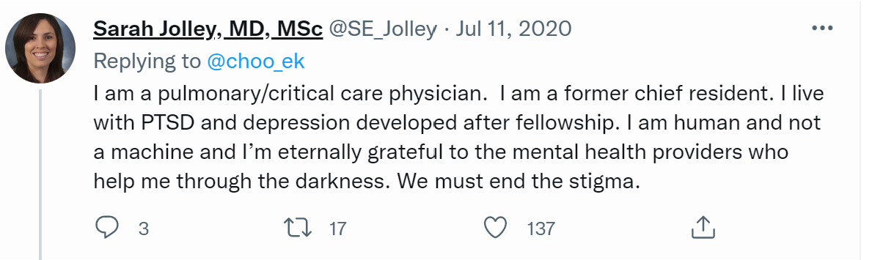
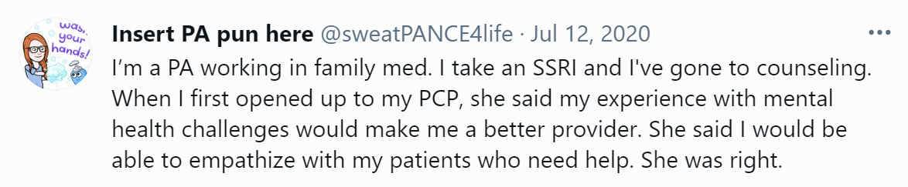
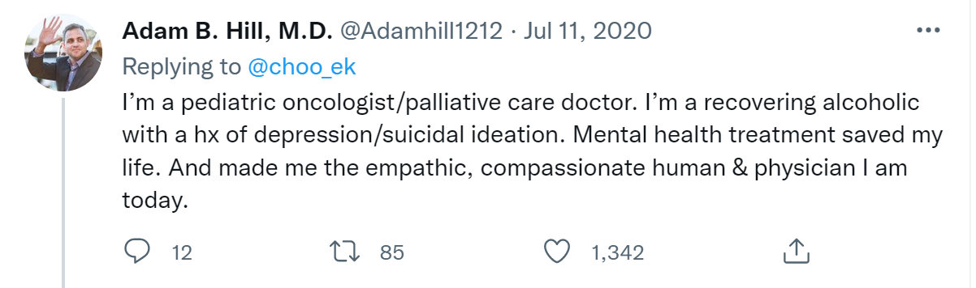
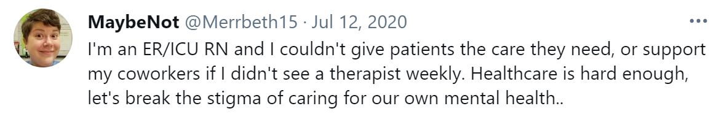
My Own Self-Stigma

Slide 25
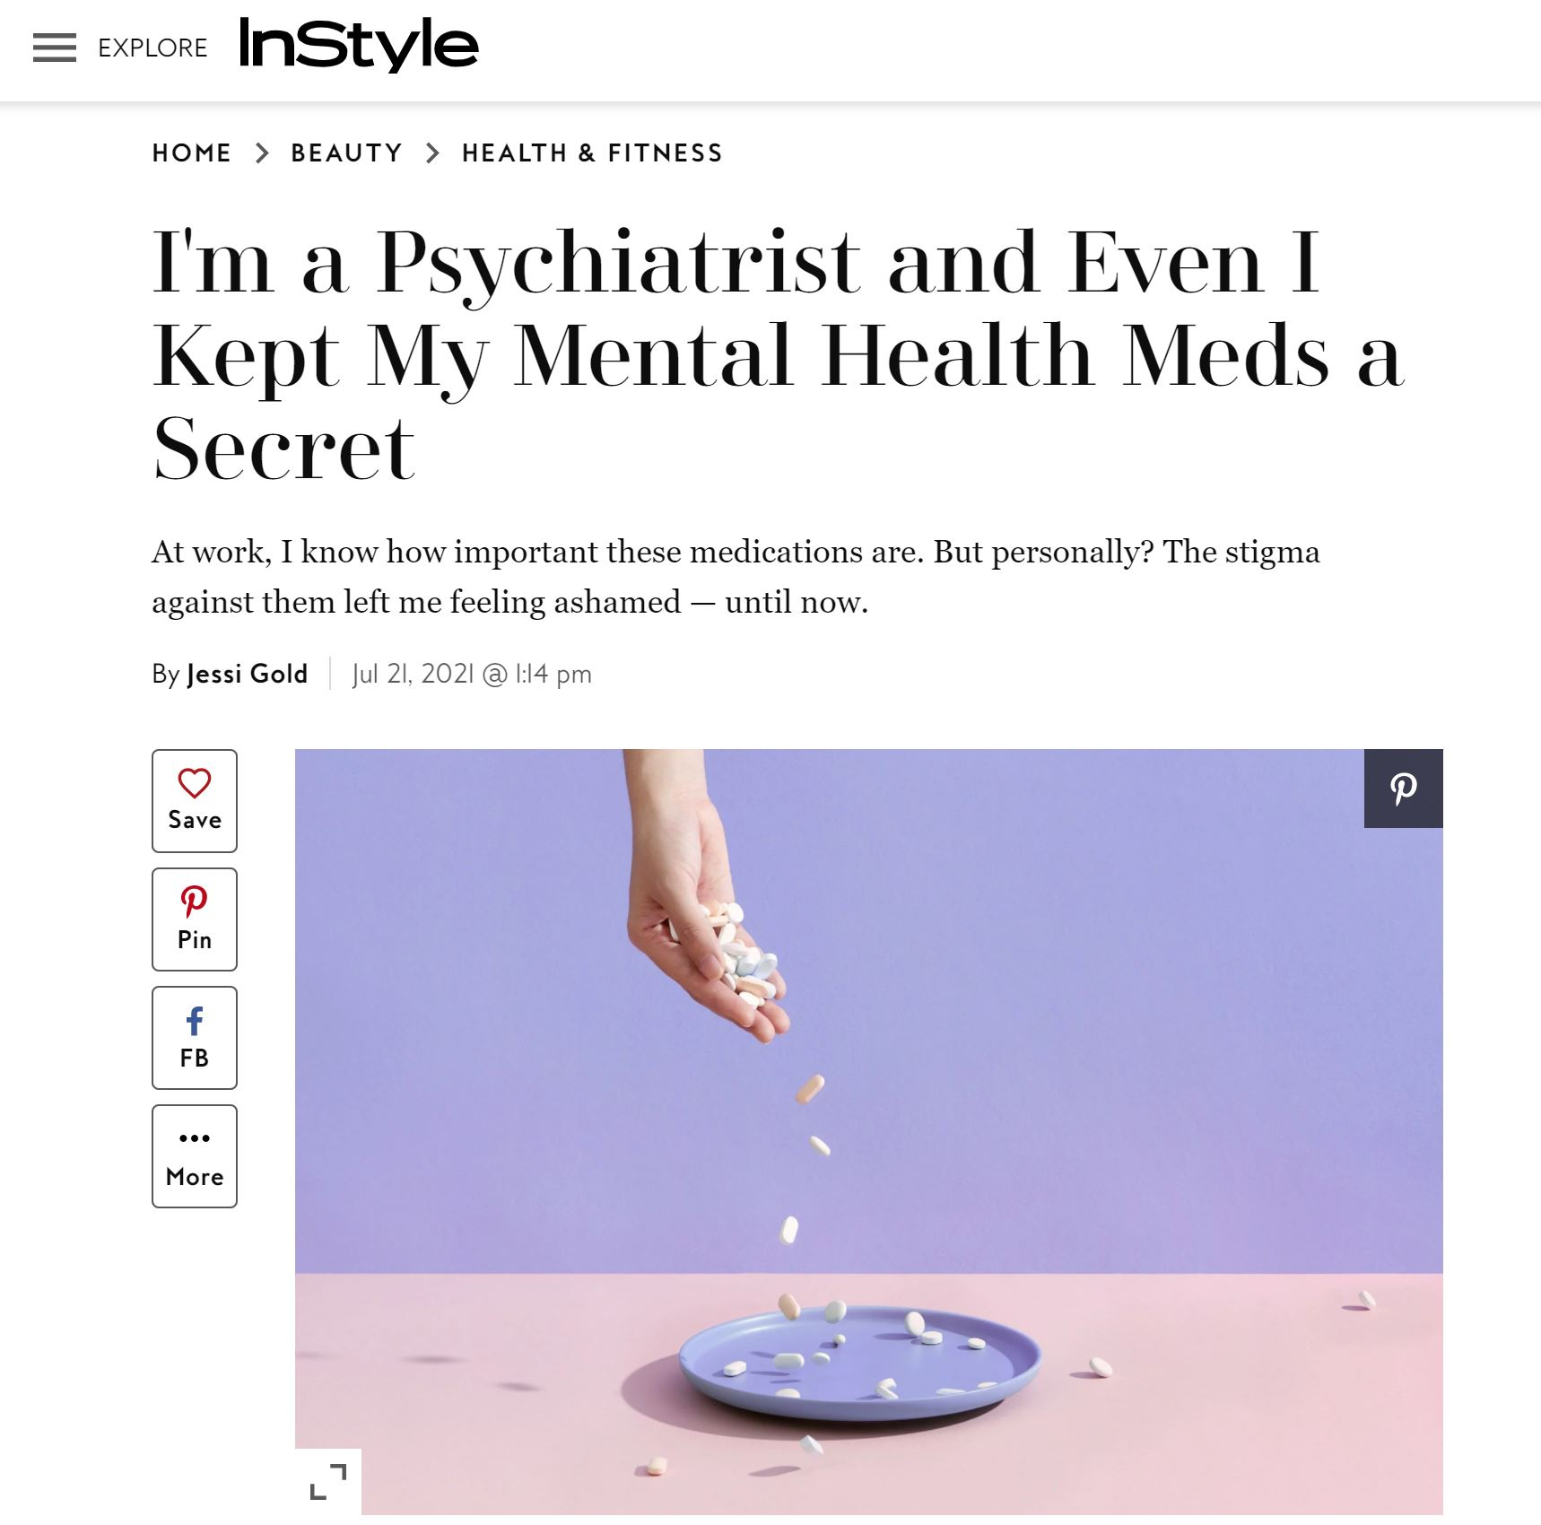
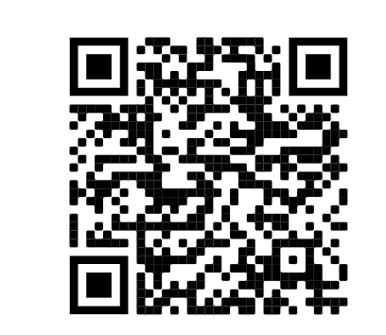
Self Stigma

Slide 26
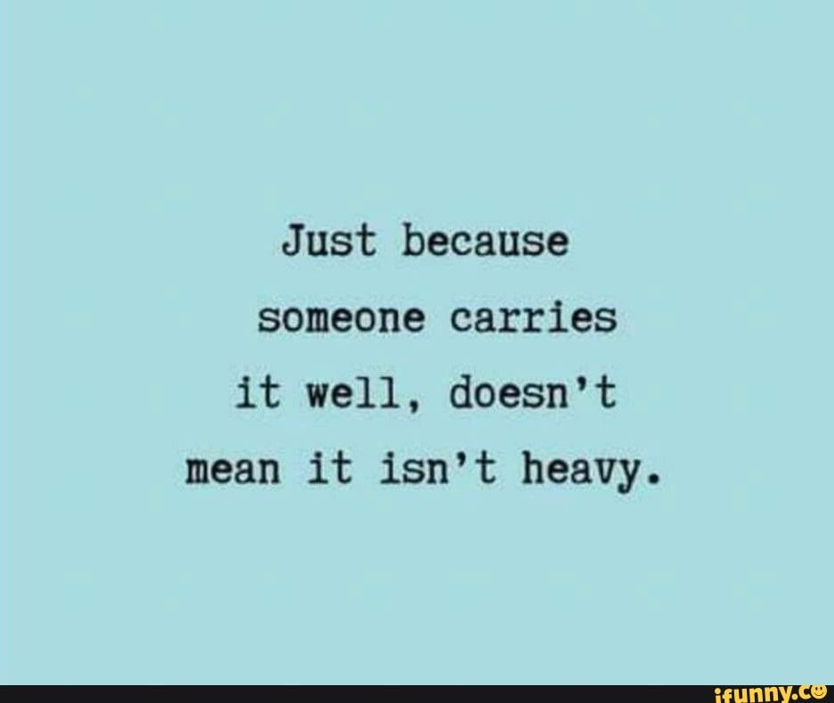
So, What Can We Do?
How To Thrive In A Broken Culture

Slide 27
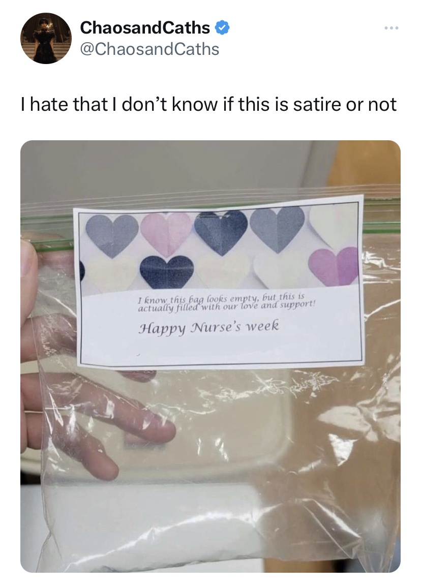
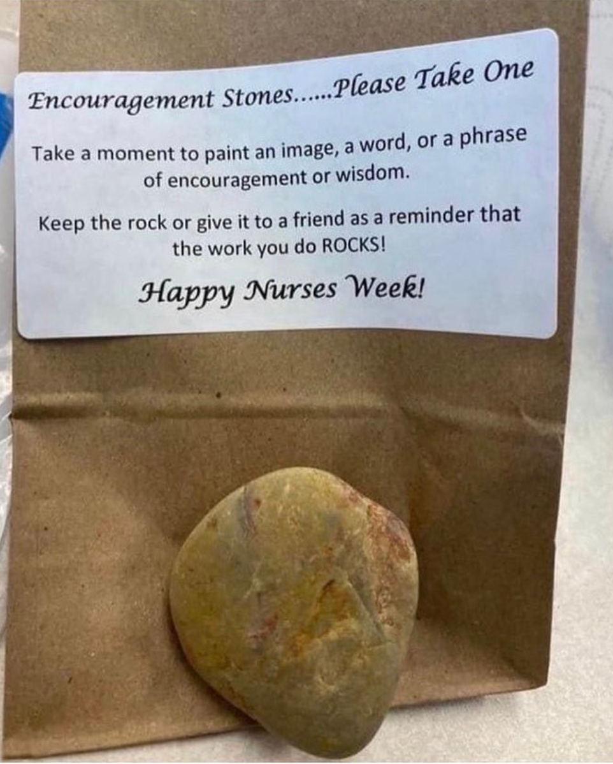
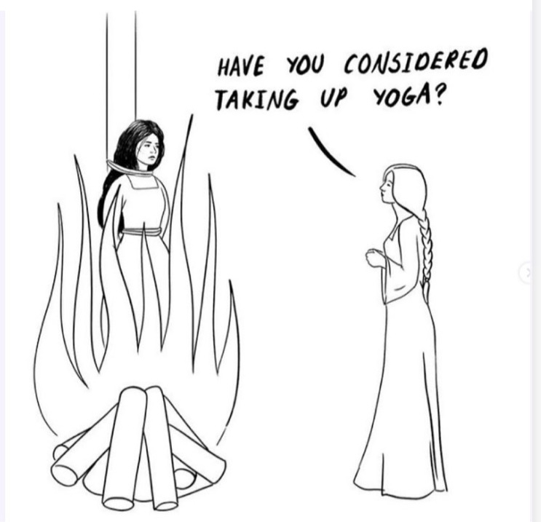
Hint: Not Fixable With Yoga And Pizza…or Commemorative Tokens

Slide 28
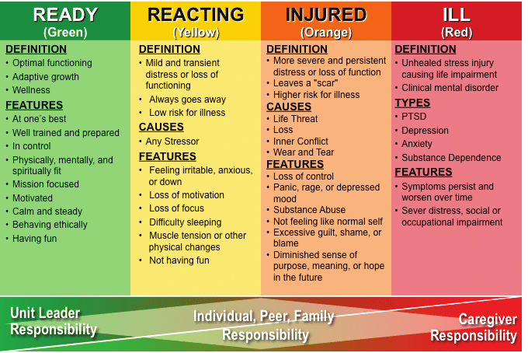
Take A Self Inventory
Corps HM. COMBAT AND OPERATIONAL STRESS FIRST AID: Caregiver Training Manual.

Slide 29

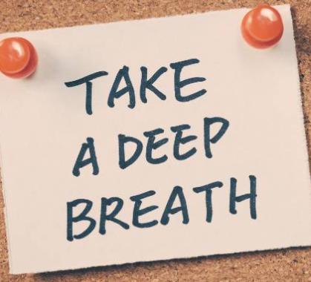


Find Skills That Work For You (Acutely and Long-Term)
Notes:
Sometimes, more concrete practices are helpful as well, like naming all of the colors you see in the room or all of the objects of a certain color in a room, or listing your favorite cars or television shows. You might even be able to ground yourself by listing the steps to a surgery or your child's bedtime routine (They showed this on Grey's Anatomy!).

Slide 30
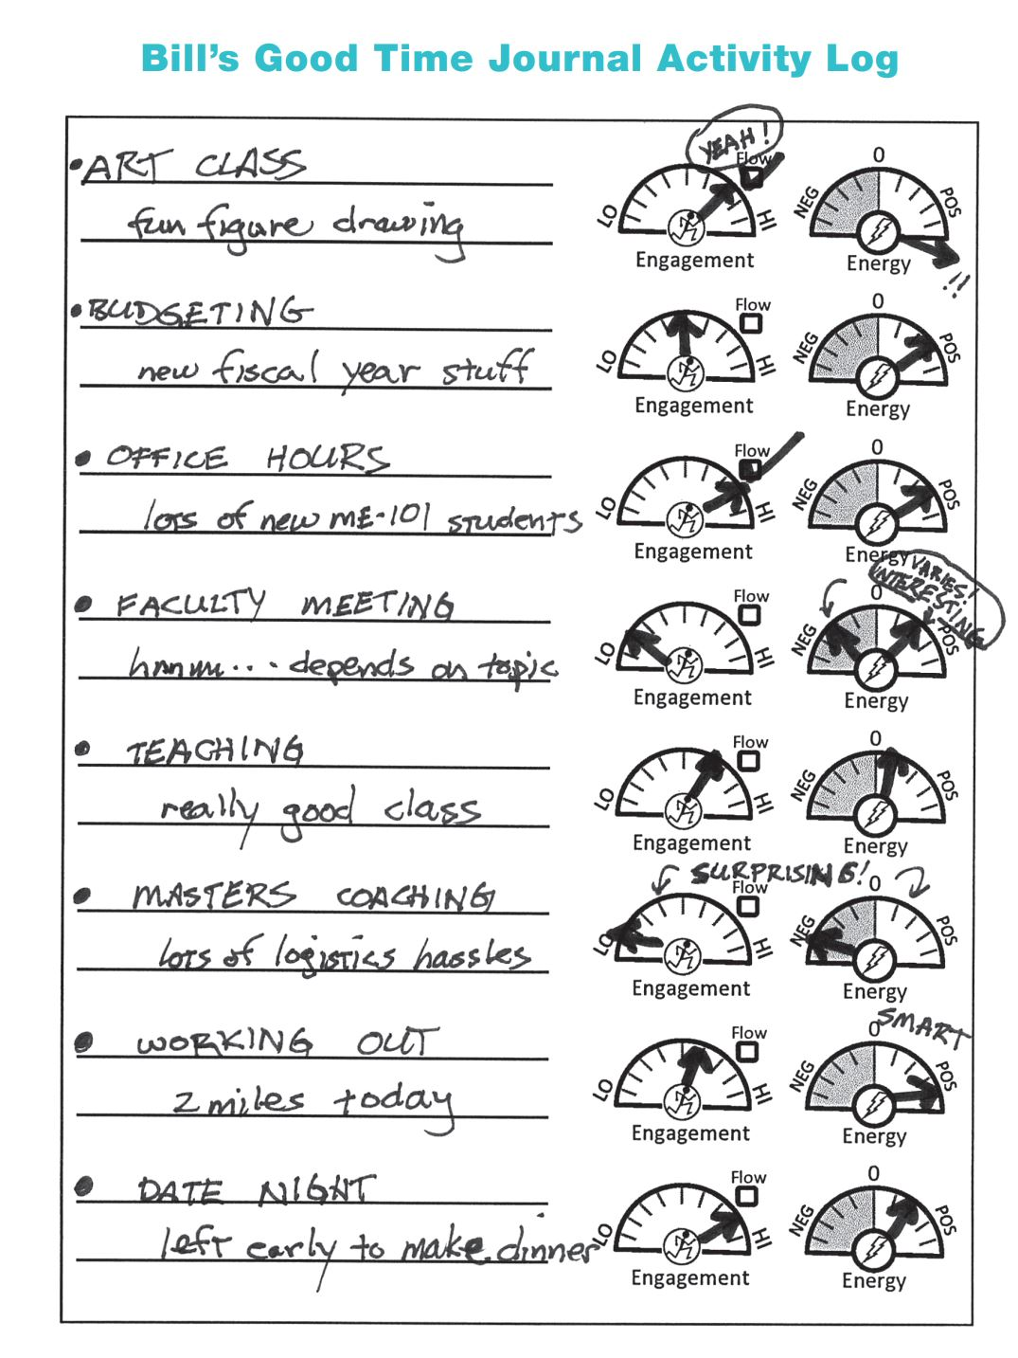
Focus On: Meaning/Purpose

Slide 31
Consider: Three Good Things
Daily for 15 days
Text reminder 2 hours before bed
  What went well today, what was your role in making that happen
  Selecting a positive emotion to describe how you felt about those good things
Significant improvements from baseline in emotional exhaustion, depression symptoms and happiness at 1 month, 6 months and 12 months, and in work–life balance at 1 month and 6 months
Exploratory subgroup analyses of participants meeting ‘concerning’ criteria at baseline revealed even larger effects at all assessment points
Sexton & Adair, 2019

Slide 32

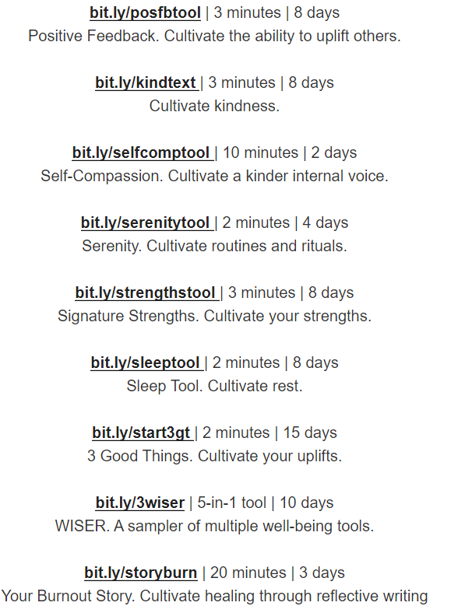
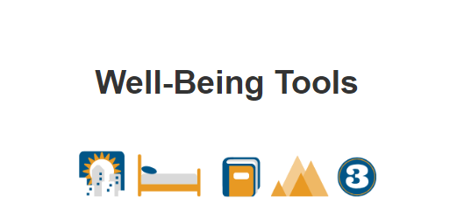
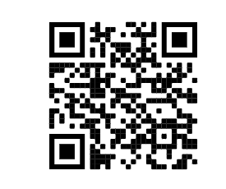

Slide 33
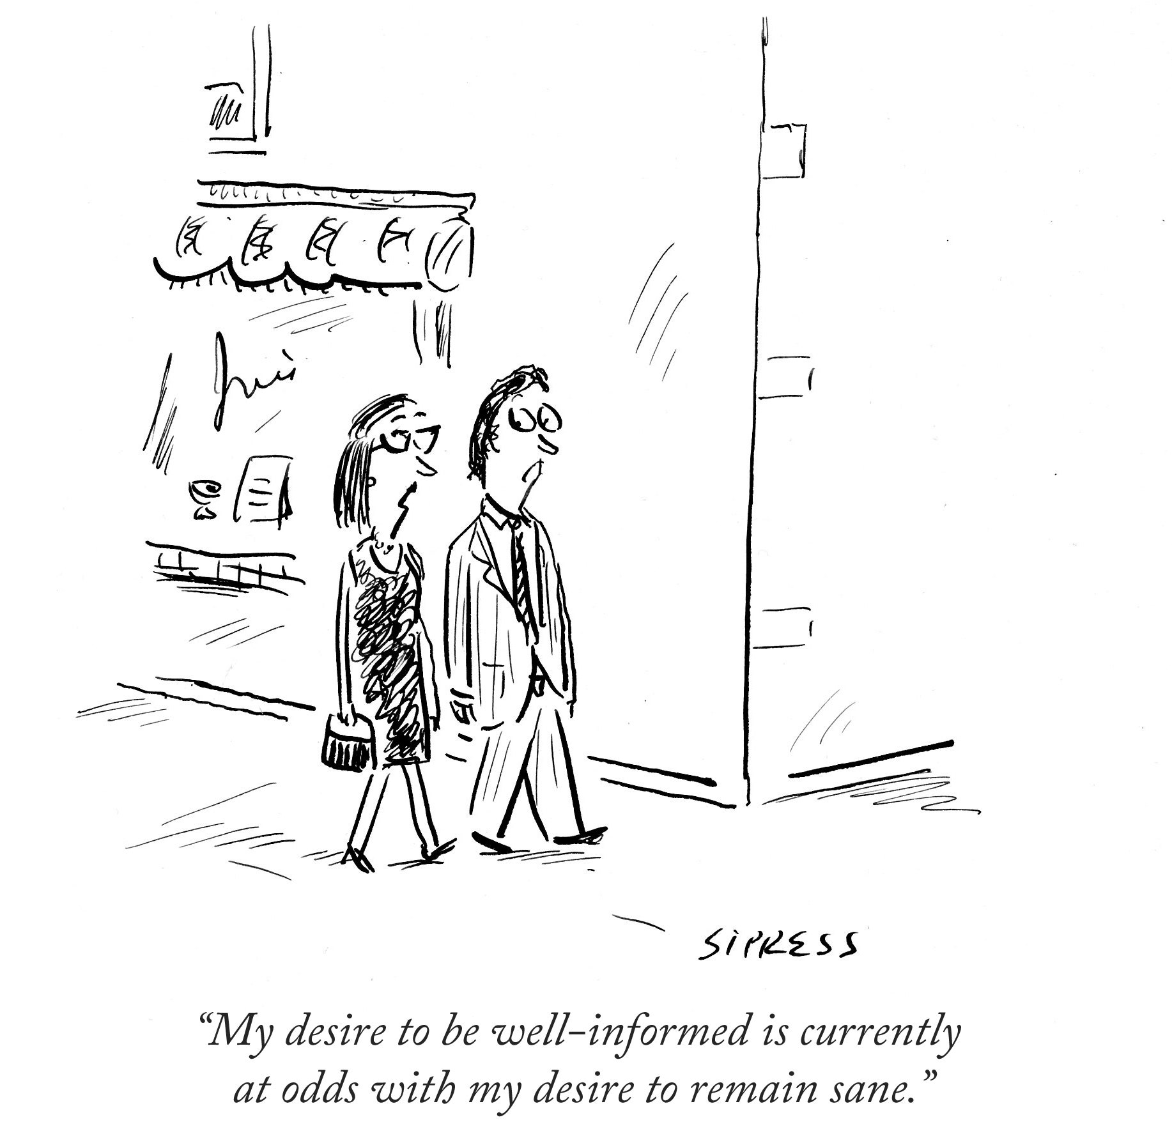
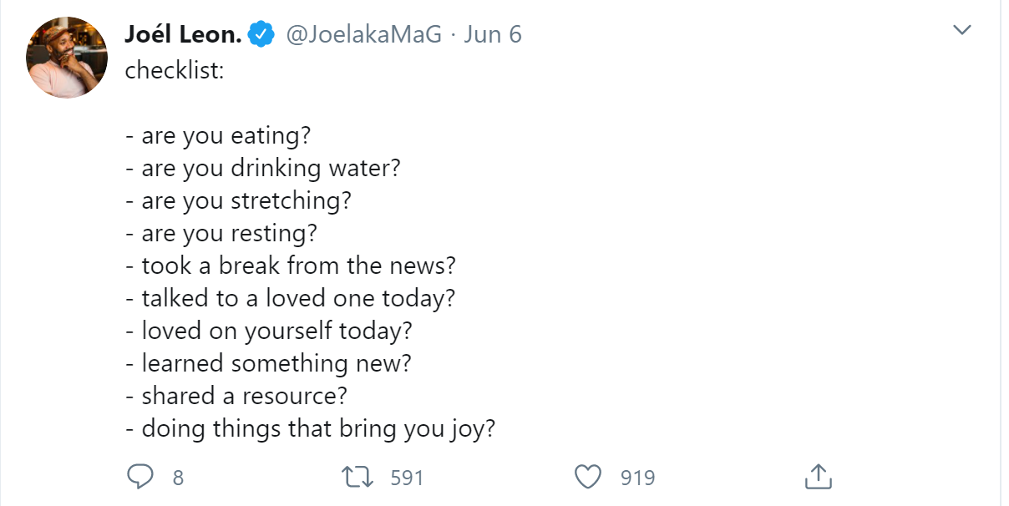
Social Media/Media Exposure Limits

Slide 34
Check-In On Others
A supportive work environment is a buffering factor of negative psychological health among healthcare workers---protects them from PTSD
  During the pandemic: social support had the greatest impact on the mental health of healthcare workers
Supportive supervisors and leadership are key
    In multilevel models, odds of burnout were 40% lower in those feeling valued by their organizations
Karakcheyeva et al, 2024
Kovner et al, 2021
Prasad et al, 2021
Feingold et al, 2021
  Si et al, 2020

Slide 35
In Other Words, Be Vulnerable
Definition: Uncertainty, risk, and emotional exposure
Self-disclosure reciprocity: Create a culture of openness and support
Courage and Empathy: Important in leadership
Birthplace of innovation and creativity

Slide 36
Even As A System: Transparency
  Be open and honest (within your own boundaries):
    Say what you know are facts, say what you don’t know but are trying to find out (or found out and can’t do, with a rationale)
    Recognize strengths and limits (of yourself and your team)
    Can’t communicate TOO MUCH
  Allow for feedback, sharing concerns
    Feeling heard is half the battle
    Acknowledge and normalize feelings

Slide 37
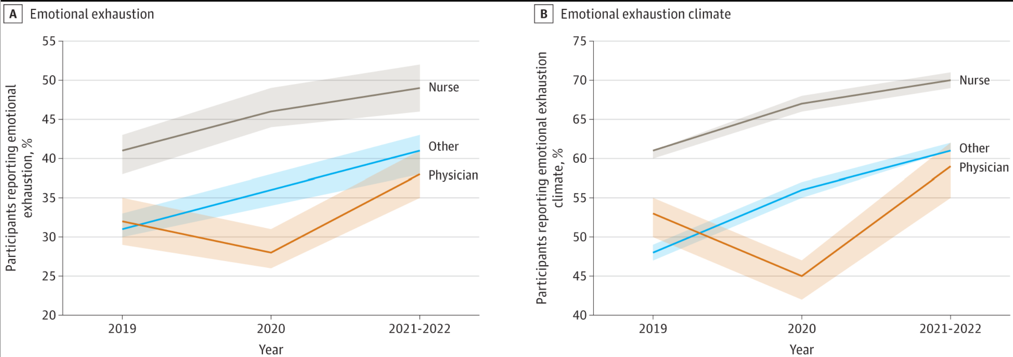
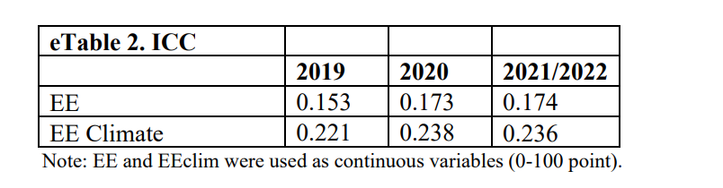
Plus, Burnout is Contagious
Intraclass correlation coefficients (ICC) describe how strongly healthcare workers in the same work setting resemble each other
.01 considered a small effect, .10 considered a medium affect, and .25 considered a large effect
Amount of shared variance at the work setting level in assessments of emotional exhaustion was 15-17%
Sexton et al, 2022

Slide 38
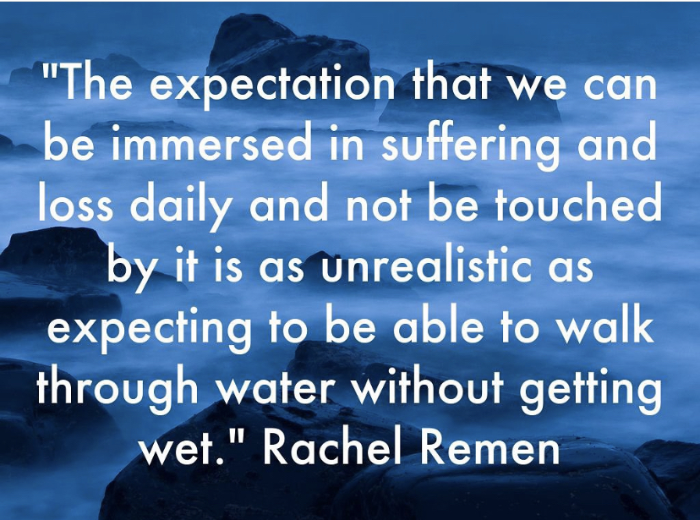
The Truth: None of Us Are Simply “Fine” & It’s about time we talked about it

Slide 39
So, Really, How Do You Feel?

Slide 40
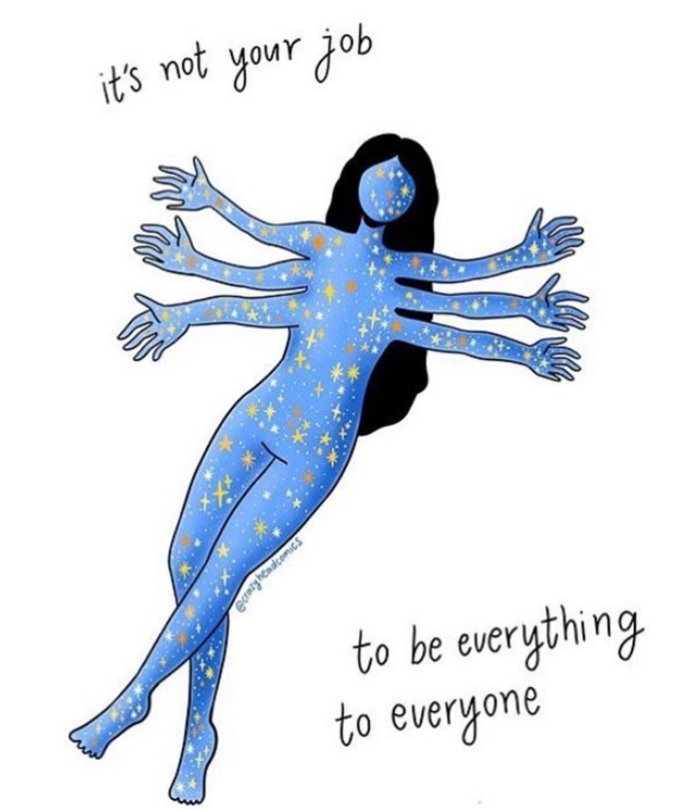
Any Questions?
@drjessigold jgold11@uthsc. edu

