Slide 1
Assessment Alchemy:
Using Evidence to Make Educational Gold
Chris Feddock, MD, MBA, MS

Slide 2
Learning Objectives
Describe the validity argument for an assessment
Outline an evidence-centered approach to assessment design
Develop a plan to design a new assessment

Slide 3
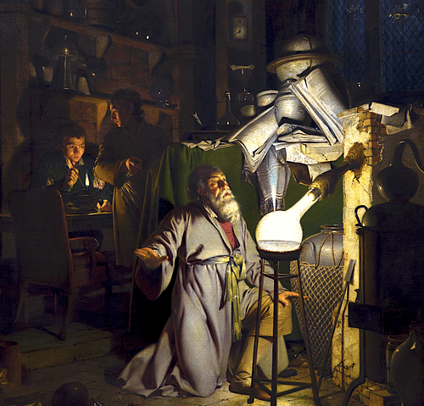
Alchemy
Natural philosophy
  How do things come into being?
  What are things made of?
  Can some things be transformed into other things?
How does assessment help students come into being?
What composes an assessment system?
The Alchemist by Joseph Wright of Derby. Oil-on-canvas painted in 1771. (Public Domain)

Slide 4


Our Goal

Slide 5
Validity Argument

Slide 6
We use a validated instrument!

Slide 7
VAlidity
Evidence supporting the accuracy of the inferences drawn from assessment outcomes for a specific purpose.
Validity is not a property of the test.
Rather, it is a property of the proposed interpretations and uses of the test scores.
Kane MT. Validating the interpretations and uses of test scores. Journal of Educational Measurement. 2013 Mar;50(1):1-73.

Slide 8
Validity Argument
Scoring
Performance scores are fair, accurate and reproducible
Generalization
Selected “test” items represent the knowledge or skill being tested
Extrapolation
Test performance accurately reflects real-life performance
Implication
Score interpretation supports the intended test use
Kane MT. Validation. In: Brennan RL, ed. Educational Measurement. 4th Edition ed. Westport, CT: Praeger Publishers; 2006.

Slide 9
Diagnostic Reasoning
PURPOSE
Provide process-level feedback on diagnostic reasoning skills with the goal of skill growth.
TARGET POPULATION
End-of-clerkship students preparing for supervised practice.
OPERATIONAL DEFINITION
Hypothesis-driven information gathering: In the context of diagnostic reasoning, the iterative process of acquiring data (through history taking, physical exam and review of diagnostic data) to generate and adapt hypotheses that explain the patient’s clinical findings based on a learner’s disease knowledge representations. ​

Slide 10


Clinical Reasoning Encounter
BEFORE ENCOUNTER | DURING ENCOUNTER | AFTER ENCOUNTER
Key Features Differential Diagnosis Up to 5 Plausible Diagnoses Most likely Diagnosis | Hypothesis-Driven Information Gathering | Key Features Differential Diagnosis Up to 5 Plausible Diagnoses Most likely Diagnosis
Notes:
Our evidence-centered approach centered on the 'Ready for supervised' practice learner or graduating medical student. So, we designed an assessment that closely replicated real clinical situations.

Slide 11

Scoring
Performance scores are fair, accurate and reproducible
Clear scoring rubrics and guidelines
Standardized rater training
Items and response options
Inter-rater reliability
Equating across cases

Slide 12

Generalization
Selected “test” items represent the knowledge or skill being tested
Purposeful sampling of relevant cases
Adequate number of cases
Generalizability theory
Reliability of observations

Slide 13

Extrapolation
Test performance accurately reflects real-life performance
Appropriate context for assessment
Think aloud study to assess consistency
Correlation with other measures
USMLE scores
WBA ratings

Slide 14

Implication
Score interpretation supports the intended test use
Purposeful design of feedback
Think aloud study to assess interpretation
Qualitative study
Intended consequences
Unintended consequences

Slide 15

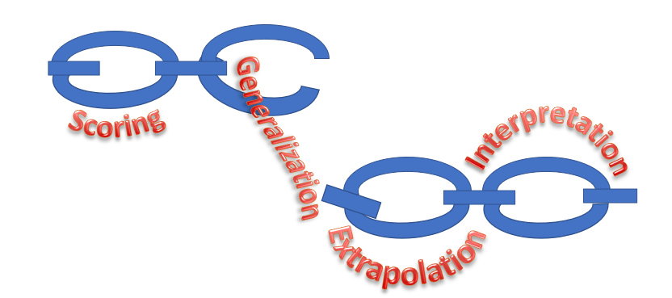
VALIDITY AS A STRUCTURED ARGUMENT
A validity argument can be conceptualized as a chain of inferences
Links represent different aspects of the argument for which evidence is needed to support score uses and/or interpretations
The validity argument is only as strong as the weakest link in the chain
Kane MT. Validation. In: Brennan RL, ed. Educational Measurement. 4th Edition ed. Westport, CT: Praeger Publishers; 2006.
Notes:
Identify the weakest link in the chain!
Validity is conceptualized as a structured argument, or chain of inferences. Components of the argument include these links in the chain:

Slide 16
TRADITIONAL Test DESIGN
Meaning of test outcomes is considered at the end of the design process.
01
Select topic
02
Write test questions
03
Calculate scores
04
Assign meaning

Slide 17

“It is only a slight exaggeration to describe the test theory that dominates educational measurement today as the application of 20th century statistics to 19th century psychology.”
Bob Mislevy, PhD
Foundations of a new test theory
Test theory for a new generation of tests
(1993)

Slide 18
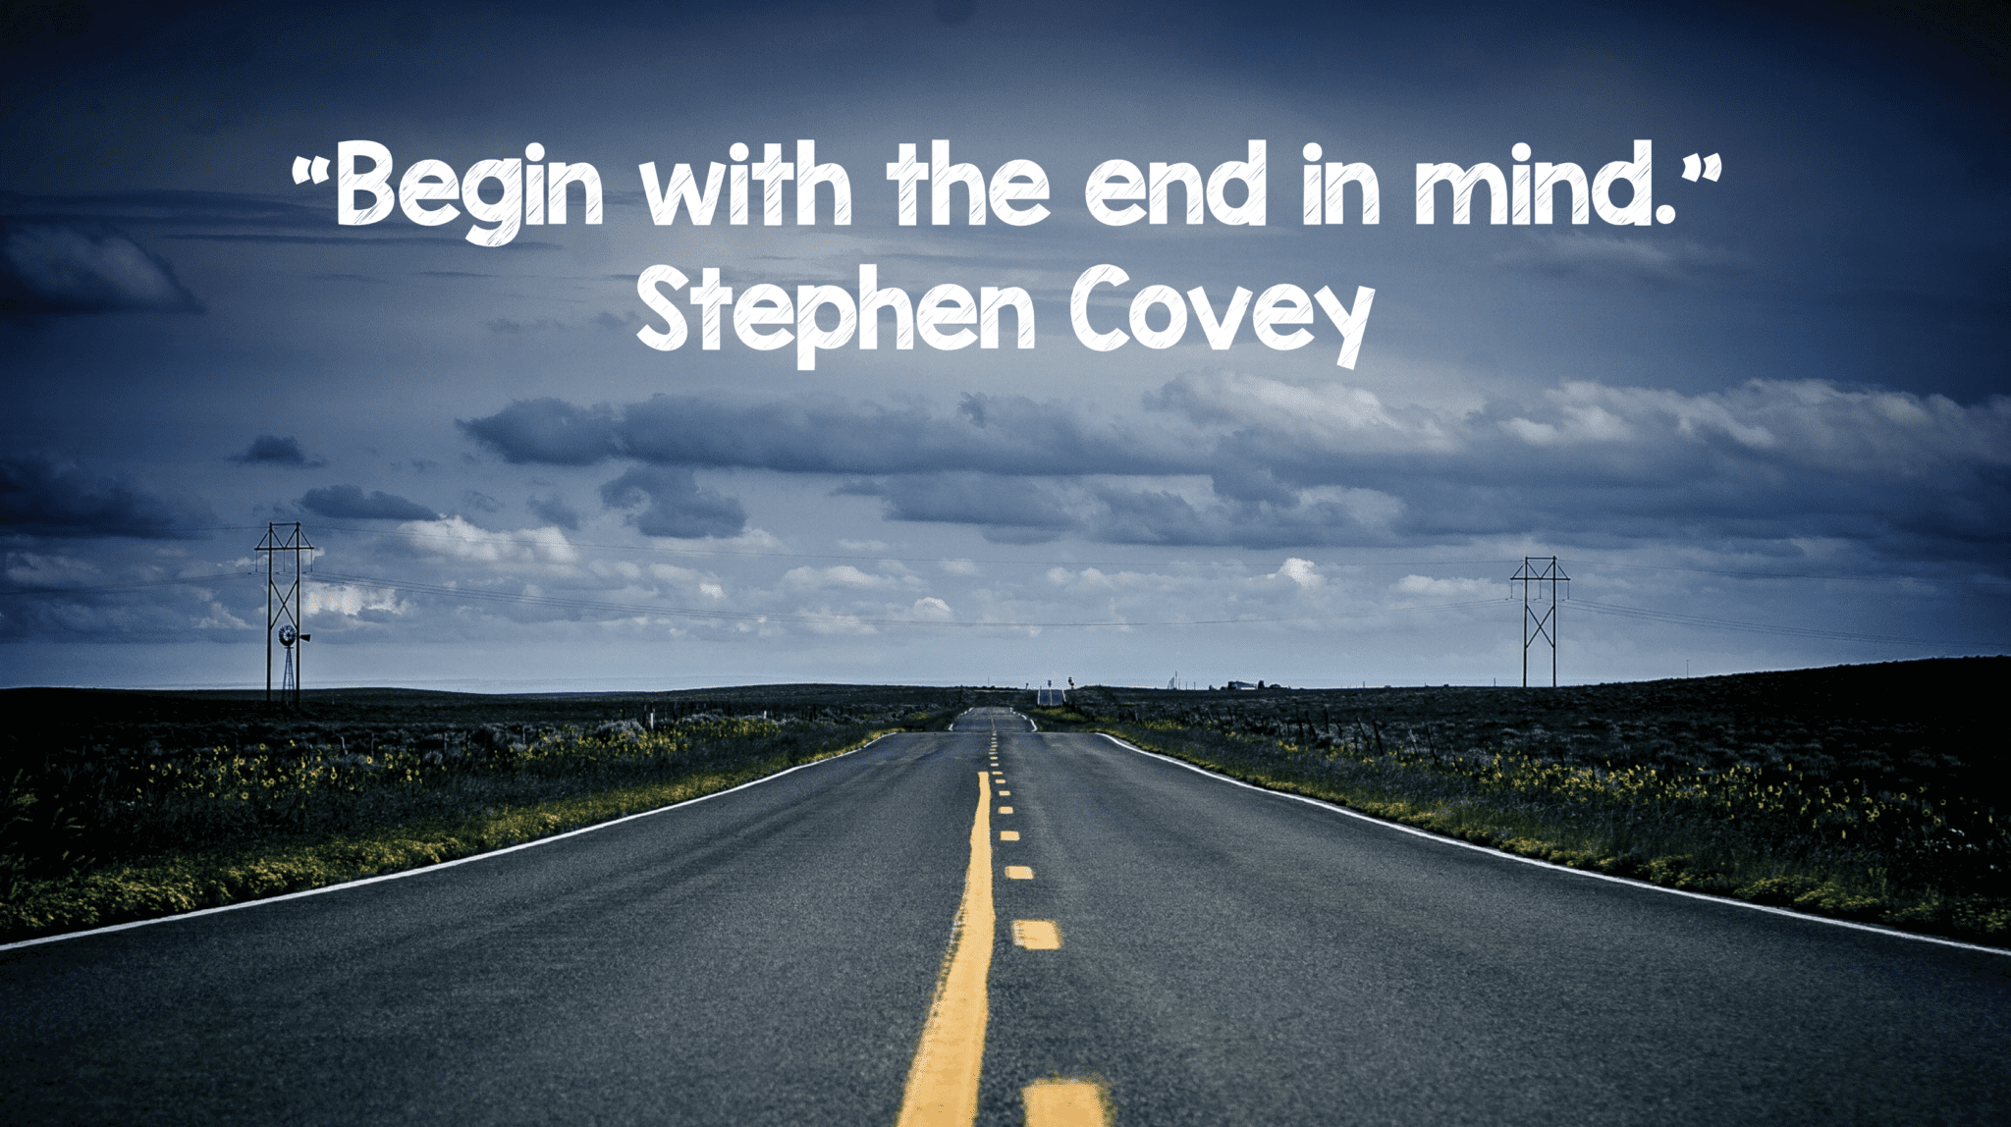
This Photo by Unknown Author is licensed under CC BY-NC-ND

Slide 19
Evidence-Centered Design (ECD)

Slide 20
Before ecd process begins…
PURPOSE
How do we want to use the assessment results?
TARGET POPULATION
Who do we want to assess?
OPERATIONAL DEFINITION
What do we want to assess?

Slide 21
ECD Begins for Clinical Reasoning
PURPOSE
Provide process-level feedback on diagnostic reasoning skills with the goal of skill growth.
TARGET POPULATION
End-of-clerkship students preparing for supervised practice.
OPERATIONAL DEFINITION
Hypothesis-driven information gathering: In the context of diagnostic reasoning, the iterative process of acquiring data (through history taking, physical exam and review of diagnostic data) to generate and adapt hypotheses that explain the patient’s clinical findings based on a learner’s disease knowledge representations. ​

Slide 22
ECD process
01
03
02
04
Claims
Evidence
Tasks
Data
Notes:
As su mentinoed, ECD is a systematic approach to designing assessment.
We start out with a list of claims we want to make about the learner. Then, we moved on to specifying the list of evidence needed to support our claims. Once we have our list of claims and evidence, we move on to designing an assessment task to help us collect those evidence. And finally, we would implement that assessment task to collect data. By going through these steps, this ensures that our assessment provides the appropriate data needed to support the claims we want to make.
I am going to walk you through more specific about the difference between claim, evidence, and task and show you a template that we used to guide this work at NBME.

Slide 23

Claim
What specifically do you want to say about a learner’s skills?
Define the claim
    A statement about a learner’s ability on a pre-defined construct
This learner can gather a hypothesis-driven history, including prioritizing patient information, generating appropriate hypotheses, using hypotheses to conduct a history, and appropriately adapting to elicited patient information.

Slide 24

Evidence
What do you need to observe from the learner to confidently make the claim?
Define the evidence
    A statement about the observable skills and behavior required to support the claim
This claim is supported by the learner identifying relevant information prior to the patient encounter, fully characterizing the chief concern, thoroughly exploring pre-encounter information and critical information elicited during the encounter.

Slide 25

Task
What activities will the learner engage to provide evidence to support the claims?
Develop the task
    A stimulus to obtain the evidence required to support the claim
Evidence is obtained by encountering a case portrayal which is intentionally designed to end with multiple diagnostic possibilities suggested by information on a patient intake form and specific elicited history, which provide support for possible diagnoses.

Slide 26

Data
What outcomes should be collected to provide the evidence for the claim?
Select the data
    The data and outcomes from the tasks and assessments that provide the evidence in support of the claim
The task and assessment result in a rating of student performance for each piece of evidence using a 4-point scale with performance anchors.

Slide 27
Evidence-Centered Approach
Claim
Evidence
Task
Data
What specifically do you want to say about a learner’s skills?
What do you need to observe from the learner to confidently make the claim?
What activities will the learner engage to provide evidence to support the claims?
What outcomes should be collected to provide the evidence for the claim?
Does the pilot data support the intended inference?
Notes:
We used the evidence-centered approach in this project
Last year we developed inferences or claims we could make about a learner’s CR skills
This year we have been more focused on the tasks and data to ensure that the information we are obtaining about a student supports the intended inference we made about their skills

Slide 28
Large Group Activity

Slide 29
Assessment Focus
Interprofessional Communication
Team Building

Slide 30
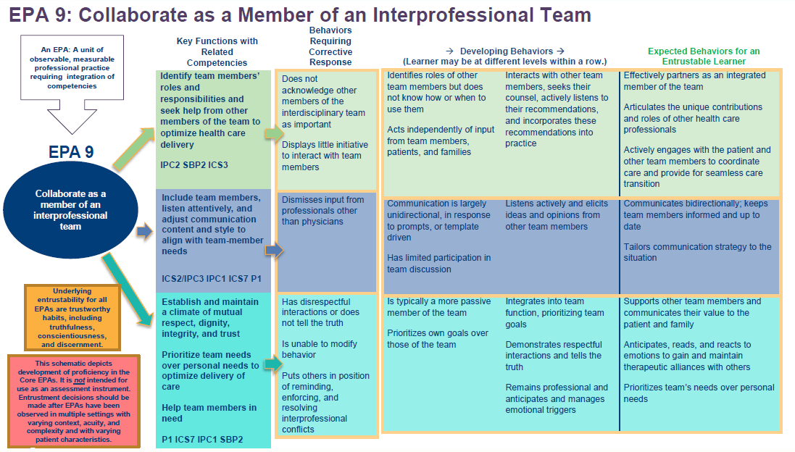

Slide 31
Interprofessional Communication
Communicate in a responsive, responsible, respectful, and compassionate manner with team members.
    Communicate one’s roles and responsibilities clearly.
    Use communication tools, techniques, and technologies to enhance team function, well-being, and health outcomes.
    Communicate clearly with authenticity and cultural humility, avoiding discipline-specific terminology.
    Promote common understanding of shared goals.
    Practice active listening that encourages ideas and opinions of other team members.
    Use constructive feedback to connect, align, and accomplish team goals.
    Examine one’s position, power, role, unique experience, expertise, and culture towards improving communication and managing conflicts
https://www.ipecollaborative.org/assets/core-competencies/IPEC_Core_Competencies_Version_3_2023.pdf

Slide 32
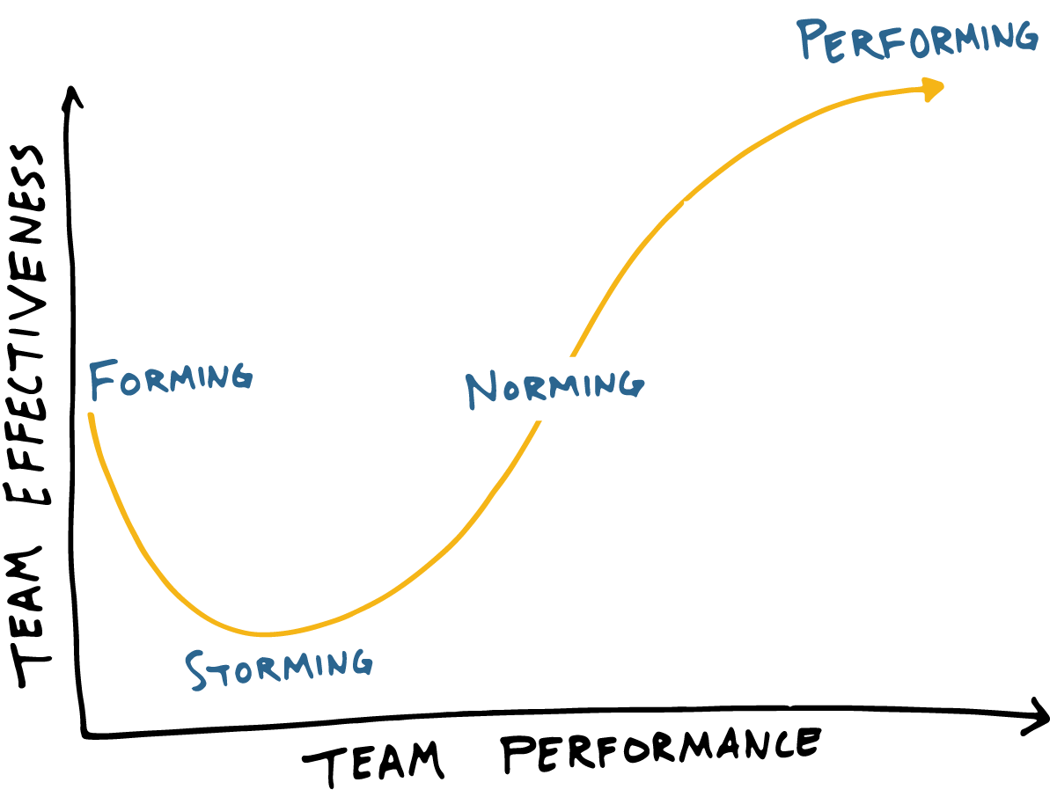
Team Building
An ongoing process that helps a work group evolve into a cohesive unit. The team members not only share expectations for accomplishing group tasks, but trust and support one another and respect one another's individual differences.

Slide 33
Before ecd process begins…
PURPOSE
Feedback on preparation for entering residency
TARGET POPULATION
Team Collaboration
OPERATIONAL DEFINITION
???

Slide 34
Small Group Activity

Slide 35
Claim
What specifically do you want to say about a learner’s skills?
Define the claim
    A statement about a learner’s ability on a pre-defined construct
This learner can ...

Slide 36
Evidence
What do you need to observe from the learner to confidently make the claim?
Define the evidence
    A statement about the observable skills and behavior required to support the claim
This claim is supported by the learner ...

Slide 37
Task
What activities will the learner engage to provide evidence to support the claims?
Develop the task
    A stimulus to obtain the evidence required to support the claim
Evidence is obtained by ...

Slide 38
Data
What outcomes should be collected to provide the evidence for the claim?
Select the data
    The data and outcomes from the tasks and assessments that provide the evidence in support of the claim
The task and assessment result in ...

Slide 39
References
All images created by Microsoft Copilot powered by DALL-E3

