Slide 1
Assessment 101
Charting a Course Beyond the Horizon

Slide 2
Learning Objectives
Describe the principles of CBME
Identify the system of assessment that supports CBME
Develop a plan to design a new assessment
Describe opportunities and challenges to integrating AI into assessment

Slide 3
Disclosures
I have no relevant financial relationships to disclose, and I do not intend to discuss off-label investigative use of drug/device/product.
The views expressed in this presentation are mine and do not necessarily reflect the position or policy of the National Board of Medical Examiners (NBME).

Slide 4
CBME

Slide 5
Competency-Based Learning
Education model based on predetermined "competencies," which focus on outcomes and real-world performance.
    Student learning is differentiated based on individual needs
    Student progress is measured by mastery of learning

Slide 6
CBME
Traditional Transitioning Competency-Based
Content-based
Develop an Outcomes Based Competency Framework Base desired outcomes on societal needs Base outcomes on practice-based abilities
Progressively sequence competencies Sequence competencies to support learner progression Recognize which competencies are building blocks for further development
Tailor learning experiences to competencies Sequence learning experiences to support learner progression Tier learning experiences to the essential abilities of a graduate
Tailor teaching to competencies Implement coaching to diagnose the learner and provide actionable feedback Ensure teaching is responsive to individual learner needs
Build a system of assessment Match multiple points and methods of data collection to each competency Provide learners with personalized, timely and meaningful feedback
Application-based
Time dependent progression
Outcome mastery progression
Set lessons to acquire content
Experiences to develop skills
Teacher-centered instruction for the “average” learner
Learner-centered instruction
Norm referenced summative assessments
Programmatic Assessment

Slide 7
Is this graduate qualified?
Completed all courses in good standing
Clinical Skills Grade = 85% (B)
    History-taking 95%
    Physical examination 95%
    Decision-making 65%
Clinical Skills Grade = 78% (C)
    History-taking 80%
    Physical examination 76%
    Decision-making 78%

Slide 8
How do you know?
Completed the Cardiovascular course
    Exam #1 78%
    Exam #2 83%
    Exam #3 82%
Completed the Cardiovascular course
    Anatomy & physiology 88%
    Infectious disorders 77%
    Dysrhythmias 98%
    Heart failure 92%
    Ischemic heart disease 84%
    Diseases of the myocardium and pericardium 66%
    Valvular heart disease 91%
    Hypertension 93%
    Vascular disorders 55%
    Congenital disorders 61%

Slide 9
What abilities Must Graduates Demonstrate?

Slide 10
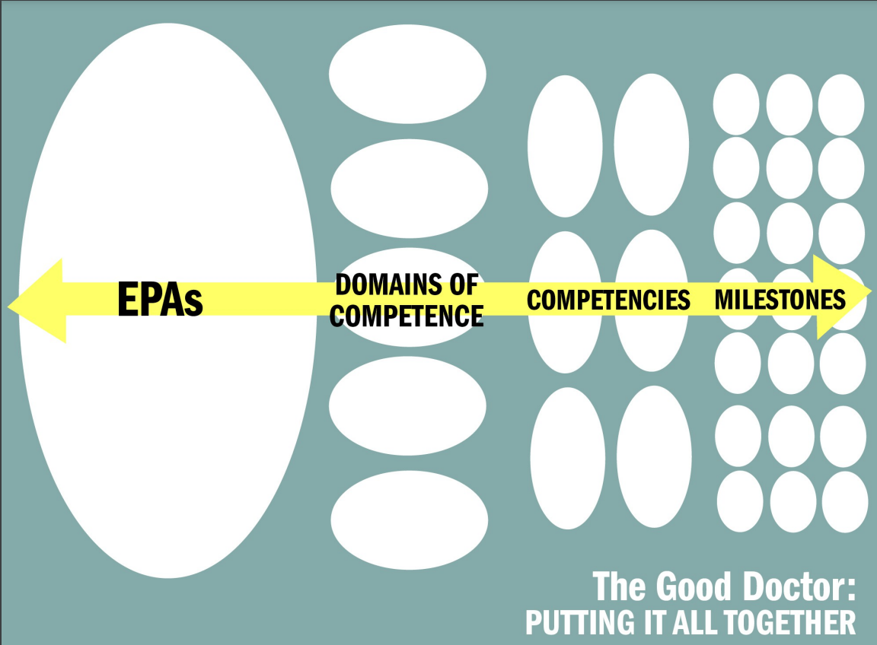
Identifying the Word Salad

Slide 11
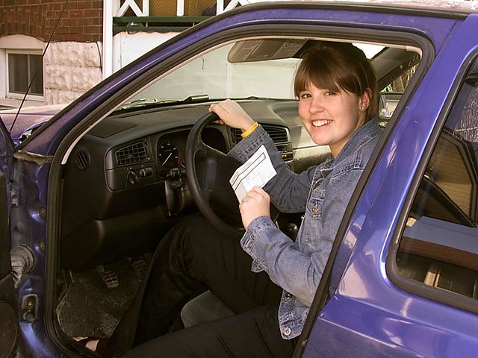
Competency
  A measurable or observable ability that is essential to the practice of medicine and requires the integration of knowledge, skills, attitudes and/or behaviors for successful completion.
Adheres to posted speed limits
Uses turn signal at appropriate times
Safely and appropriately turns from one road on to another
This Photo by Unknown Author is licensed under CC BY-NC-ND

Slide 12
Competencies (PCRS)
Patient Care
    PC2: Gather essential and accurate information about patients and their conditions through history-taking, physical examination, and the use of laboratory data, imaging, and other tests
    PC4: Interpret laboratory data, imaging studies, and other tests required for the area of practice
Knowledge for Practice
    KP1: Demonstrate an investigatory and analytic approach to clinical situations
    KP3: Apply established and emerging principles of clinical sciences to diagnostic and therapeutic decision-making, clinical problem-solving, and other aspects of evidence-based health care
Interpersonal & Communication Skills
    ICS1: Communicate effectively with patients, families, and the public, as appropriate, across a broad range of socioeconomic and cultural backgrounds
    ICS2: Communicate effectively with colleagues within one’s profession or specialty, other health professionals, and health related agencies
Professionalism
    P5: Demonstrate sensitivity and responsiveness to a diverse patient population, including but not limited to diversity in gender, age, culture, race, religion, disabilities, and sexual orientation

Slide 13

How do I assess this?
PC2: Gather essential and accurate information about patients and their conditions through history-taking, physical examination, and the use of laboratory data, imaging, and other tests
This Photo by Unknown Author is licensed under CC BY-NC

Slide 14

Entrustable Professional Activities (EPAs)
  Unit of professional practice, defined as tasks or responsibilities to be entrusted to the unsupervised execution by a trainee once he or she has attained sufficient specific competence. EPAs are independently executable, observable, and measurable in their process and outcome, and therefore, suitable for entrustment decisions.
Drives on an interstate highway

Slide 15
EPAs for Entering Residency
EPA1
    Gather a History and Perform a Physical Examination
EPA2
    Prioritize a Differential Diagnosis Following a Clinical Encounter

Slide 16
EPAs to Competencies
PC2
Milestone 1 | Milestone 2 | Milestone 3 | Milestone 4
EPA1
Gather a History and Perform a Physical Examination
PC4
KP1
KP3
EPA2
Prioritize a Differential Diagnosis Following a Clinical Encounter
ICS1
ICS2
P5

Slide 17

Milestone
  A significant point in the development of specific competencies, which describes the performance level trainees are expected to demonstrate for knowledge, skills, attitudes, and/or behaviors.
Adheres to posted speed limits
Does not exceed the speed limit
Maintains speeds between the minimum and maximum for the road
Maintains a constant safe speed with the flow of traffic

Slide 18
PC2 Milestones
PC2: Gather essential and accurate information about patients and their conditions through history-taking, physical examination, and the use of laboratory data, imaging, and other tests
Does not collect accurate historical data | Gathers excessive or incomplete data Does not deviate from a template | Uses logical progression of prioritized questions | Obtains a complete and accurate history in an organized fashion.
Incorrectly performs basic physical exam maneuvers | Performs basic exam maneuvers correctly but misses key findings | Targets the exam to areas necessary for the encounter Identifies and describes normal findings | Performs an accurate exam in logical and fluid sequence Identifies and describes normal and abnormal findings
Cannot gather or synthesize data | Struggles to filter and prioritize sources of data | Gathers appropriate data bases on initial diagnostic hypotheses | Gathers information across multiple sources in a hypothesis-driven fashion
EPA1
Gather a History and Perform a Physical Examination
EPA2
Prioritize a Differential Diagnosis Following a Clinical Encounter

Slide 19
Competence
  The array of abilities across multiple domains or aspects of performance in a certain context. Statements about competence require descriptive qualifiers to define the relevant abilities, context, and stage of training. Competence is multi-dimensional and dynamic.
Specific EPAs
3rd year student
Sub-intern
Intern
Resident
Level of supervision
Clinical setting
Patient complexity

Slide 20
Competence
 | EPA1: Gather a History and Perform a Physical Examination
PC2 | Does not collect accurate historical data | Gathers excessive or incomplete data Does not deviate from a template | Uses logical progression of prioritized questions | Obtains a complete and accurate history in an organized fashion.
PC2 | Incorrectly performs basic physical exam maneuvers | Performs basic exam maneuvers correctly but misses key findings | Targets the exam to areas necessary for the encounter Identifies and describes normal findings | Performs an accurate exam in logical and fluid sequence Identifies and describes normal and abnormal findings
KP1 | Fails to recognize the patient’s central problem | Questions are not guided by the evidence and data collected | Questions are purposefully used but inconsistently identifies pertinent information | Demonstrates hypothesis-driven questioning
ICS1 | Ineffectively communicates with patients | Communicates unidirectionally and does not respond to patient cues | Demonstrates effective communication skills and avoids jargon | Adapts communication style to the individual needs of the patient
P5 | Disrespectful in patient interactions | May generalize based on patient characteristics | Appropriately adapts to a patient’s unique characteristics | Demonstrates respect for all patients regardless of background
Notes:
Modified Chen Entrustment Scale

Slide 21
COMPETENCE
Learners must be entrusted to do activities that they have never been assessed on.

Slide 22

Entrustment Decision
Competence
Trustworthiness
Discernment
Truthfulness
Conscientiousness
I entrust you to drive on city streets during the day if it is not raining or snowing.

Slide 23
Entrustment
 | EPA1: Gather a History and Perform a Physical Examination
PC2 | Does not collect accurate historical data | Gathers excessive or incomplete data Does not deviate from a template | Uses logical progression of prioritized questions | Obtains a complete and accurate history in an organized fashion.
PC2 | Incorrectly performs basic physical exam maneuvers | Performs basic exam maneuvers correctly but misses key findings | Targets the exam to areas necessary for the encounter Identifies and describes normal findings | Performs an accurate exam in logical and fluid sequence Identifies and describes normal and abnormal findings
KP1 | Fails to recognize the patient’s central problem | Questions are not guided by the evidence and data collected | Questions are purposefully used but inconsistently identifies pertinent information | Demonstrates hypothesis-driven questioning
ICS1 | Ineffectively communicates with patients | Communicates unidirectionally and does not respond to patient cues | Demonstrates effective communication skills and avoids jargon | Adapts communication style to the individual needs of the patient
P5 | Disrespectful in patient interactions | May generalize based on patient characteristics | Appropriately adapts to a patient’s unique characteristics | Demonstrates respect for all patients regardless of background
As a third-year, this student is entrusted to gather a history and perform a physical examination as part of the inpatient ward service with resident supervision immediately available.
Notes:
Modified Chen Entrustment Scale

Slide 24
Entrustment Caveats
Competence
Relevant abilities in a specific context at a stage of training
Trustworthiness
Discernment: awareness of the limits of one’s clinical knowledge and skill
Truthfulness: appropriate balance of truth and tact
Conscientiousness: thoroughness and dependability in following through with assigned tasks
. Acad Med. 2017 Jun;92(6):774-779.
Notes:
Brown DR, Warren JB, Hyderi A, Drusin RE, Moeller J, Rosenfeld M, Orlander PR, Yingling S, Call S, Terhune K, Bull J, Englander R, Wagner DP; AAMC Core Entrustable Professional Activities for Entering Residency Entrustment Concept Group. Finding a Path to Entrustment in Undergraduate Medical Education: A Progress Report From the AAMC Core Entrustable Professional Activities for Entering Residency Entrustment Concept Group. Acad Med. 2017 Jun;92(6):774-779.

Slide 25
System of Assessment

Slide 26

Are Your Assessments designed to the end of a course?

Slide 27
Focus on a single element of competence
Assumption of learning
Limited ability to integrate to meet the overall purpose
Triangulation based on complementary information
Norcini J, Anderson MB, Bollela V, Burch V, Costa MJ, Duvivier R, Hays R, Palacios Mackay MF, Roberts T, Swanson D. 2018 Consensus framework for good assessment. Med Teach. 2018 Nov;40(11):1102-1109. doi: 10.1080/0142159X.2018.1500016. Epub 2018 Oct 9. PMID: 30299187.

Slide 28
What is a system of assessment?
Coherent
Multiple, coordinated individual assessments
Continuous
Individual results contribute cumulatively
Comprehensive
Formative and summative components
Feasible
Practical, realistic, efficient, and sensible
Purpose driven
Supports the purposes for which it was created
Transparent and free from bias
Stakeholders believe decisions are fair and equitable
Acceptable
Assessment process and results are credible and evidence-based

Slide 29
System of Assessment
Learning Activities |  | Competency Review |  | Competency Review |  | Final Competency Review
Assessments for Learning
Assessments of Learning
 | Period 1 |  | Period 2 |  | Period 3

Slide 30
Programmatic Assessment
Specific System of Assessment
Decision-making based on multiple data points using multiple assessment tools
Multiple methods of assessment
Decision-making in which the number of data points is proportionally related to the stakes of a decision
Learners use their performance data to self-reflect and direct their own learning with the support of learning coaches
Progression decisions based on professional judgment (by a group of experts) of the compiled evidence from multiple observers
Ross S, Hauer KE, Wycliffe-Jones K, Hall AK, Molgaard L, Richardson D, Oswald A, Bhanji F; ICBME Collaborators. Key considerations in planning and designing programmatic assessment in competency-based medical education. Med Teach. 2021 Jul;43(7):758-764. doi: 10.1080/0142159X.2021.1925099. Epub 2021 Jun 1. PMID: 34061700.

Slide 31
Types of Assessment

Slide 32
Miller’s Pyramid of Competence
Behavior
Cognition
Does
Shows How
Knows How
Knows
Workplace-based Assessment (WBA)
Objective-Structured Clinical Exam (OSCE)
MCQs
MCQs
Simulation
Virtual reality
Essay
Short answer
Oral examination
Patient outcomes
Procedure/Case logs

Slide 33
Scope of Assessments
Assessment for Learning
Assessment of Learning
Low Stakes High Stakes
Feedback to learners about their learning | Pass-Fail decision
Learner oriented to feedback | Learner oriented to passing the “test”
Learners follow up on feedback | Learners ignore feedback
Requires meaningful feedback | Requires a performance standard
Words > Scores | Relation to performance standard
BMC Med Educ. 2013;13:123.

Slide 34
Feedback Essentials
Purpose
Reduce discrepancy between current performance and desired goal
Students
Effective learning strategies
Teachers
Appropriate feedback and challenging goals
Effective Feedback
Where am I going? (Goals) How am I going? (Gap) Where to next? (Strategies)
Task Level
How well task was performed
(Does not generalize)
Process Level
How task was performed
(Enhances deeper learning)
Self-Regulation Level
Learner perception
(Essential for learning)
Self Level
Personal evaluation
(Least Effective)
“You asked about 6 of the 8 elements of the chief concern”
“You asked most elements of the chief concern, but context is important...”
“How would you handle this situation next time?”
“Great effort!”
Review of Educational Research. 2007;77(1):81-112
Notes:
There can be a powerful interactive effect between feedback aimed at improving the strategies and processes and feedback aimed at the more surface task information.

Slide 35
System priorities
Formative assessment
Workplace-based assessment
Performance in context
Skills and Behaviors
Outcomes of learning
Feedback for learner growth

Slide 36
Use of Generative AI For Assessment

Slide 37
Generative AI (ChatGPT)
Chat
Generative
Pre-Trained
Natural language understanding
Natural language generation
Transformer
Access to a large corpus of information
Context specificity

Slide 38
Cautions with Generative AI
Inconsistent
Hallucination
Incomplete
Answers are probabilistic, but not the most probable!
Generator can perceive nonexistent patterns, creating nonsensical or inaccurate output.
Training corpus has not been revealed – unclear medical knowledge.
Biased
Repeats biases existing in the training corpus.

Slide 39
AI in Support of Assessment
Methods & Measures
Case development
Delivery
AI interactions (chatbots, artificial humans)
MCQ development
Rubric development
Data Collection
Natural language processing (audio or written transcripts)
Data Analysis
Automated scoring
Text analysis
Results
Prioritized feedback (strengths, weaknesses, gaps)

Slide 40
AI for Master Adaptive Learner
Recommendations for deliberate practice
Resources for improvement
Assessment results for individual skills or competencies
Prioritized individual feedback
Comparison of self assessment to assessment results
Quality improvement results to inform strategy
Cutrer WB, Miller B, Pusic MV, Mejicano G, Mangrulkar RS, Gruppen LD, Hawkins RE, Skochelak SE, Moore DE Jr. Fostering the Development of Master Adaptive Learners: A Conceptual Model to Guide Skill Acquisition in Medical Education. Acad Med. 2017 Jan;92(1):70-75. doi: 10.1097/ACM.0000000000001323. PMID: 27532867.

Slide 41
Prompt Structure
A
Define how the AI should act
U
Describe the user or audience
T
O
M
A
T
Explain the targeted action with meaningful verb
Define the output
Describe the mode or tone of the output (default is intelligent)
Describe atypical limits (if integrated into an application)
Describe any topic whitelisting (if conversational)

Slide 42
Prompt Structure
A
Act as a medical teacher
U
T
O
For a medical student on their pediatric clerkship rotation
Generate a multiple-choice question for the learning objective, “compare and contrast features of infectious exanthems.”
Question consists of a clinical vignette and five answer options. Provide the correct answer and rationale.

Slide 43
Output
  A 4-year-old child is brought to the clinic with a 3-day history of fever and a rash. The fever was initially high at 39°C but has now subsided. The rash began as small pink spots on the trunk and then spread to the neck and extremities. The child appears irritable but has no other significant symptoms. Physical examination reveals a maculopapular rash with no vesicles or pustules.
  Based on the clinical vignette, which of the following infectious exanthems is the child most likely experiencing?
  Measles (Rubeola)
  Scarlet Fever
  Fifth Disease (Erythema Infectiosum)
  Chickenpox (Varicella)
  Roseola (Exanthem Subitum)

Slide 44
Rationale
  Correct Answer: E) Roseola (Exanthem Subitum)
  Rationale: The clinical presentation is typical of Roseola, also known as Exanthem Subitum, which is characterized by a high fever that resolves abruptly followed by the appearance of a maculopapular rash. The rash often starts on the trunk and then spreads to the neck and extremities. The absence of vesicles or pustules and the pattern of fever followed by rash are key features distinguishing Roseola from other infectious exanthems.

Slide 45
Prompt Structure
A
Act as a medical teacher
U
T
O
For a medical student on their pediatric clerkship rotation
Generate a multiple-choice question for the learning objective, “identify the features of roseola.”
Question consists of a clinical vignette and five answer options. Provide the correct answer and rationale.

Slide 46
Output #2
  A 2-year-old child is brought to the pediatric clinic by their parents. The child has been febrile for the past three days, with temperatures ranging from 38.5°C to 39.5°C. The fever has been intermittent and is associated with irritability. On examination, the child appears well-hydrated and playful. There are no signs of respiratory distress or focal infections. However, the parents mention that the child had a high fever that suddenly resolved yesterday evening. Today, they noticed a faint pink rash on the child’s trunk and extremities.
  Based on the clinical vignette, which of the following infectious exanthems is most likely responsible for these findings?
  Measles (Rubeola)
  Scarlet Fever
  Fifth Disease (Erythema Infectiosum)
  Chickenpox (Varicella)
  Roseola (Exanthem Subitum)

Slide 47
Rationale #2
  Correct Answer: E) Roseola (Exanthem Subitum)
  Rationale:
  The clinical presentation described in the vignette is consistent with roseola, also known as exanthem subitum. Key features include:
    High Fever Followed by Rash: Roseola typically presents with several days of high fever (often >39°C) that abruptly resolves, followed by the appearance of a maculopapular rash.
    Rash Characteristics: The rash is faint pink and usually starts on the trunk before spreading to the neck and extremities. It is non-pruritic and blanches with pressure.
    Age Group: Roseola commonly affects children aged 6 months to 3 years.
    Causative Agent: Human herpesvirus 6 (HHV-6) is the primary cause of roseola.
  Remember that roseola is usually a benign and self-limiting condition. Differentiating it from other exanthems (such as measles, scarlet fever, and chickenpox) based on the clinical features is essential for accurate diagnosis and appropriate management.

Slide 48

Questions

Slide 49
Workplace-Based Assessment
Global Practice Assessment Over Time
Mini Clinical Evaluation Exercise (Mini-CEX)
Indirect Observation of Decision Making
Case-based discussion/presentation
Direct Clinical Encounter Observation
Multi-source feedback
Patient feedback
Direct Observation of Procedural Skills (DOPS)
Objective Structured Assessment of Technical Skills (OSATS)
Review of Practice
Clinical record review
Clinical audit
BMC Med Educ. 2013 Sep 11;13:123.

Slide 50
References
All images created by Microsoft Copilot powered by DALL-E3

