Slide 1

Laying the Groundwork: Enhancing Medial School Preparedness Through Pre-Matriculation and Mentoring
Stephanie Dearden, MA, NCC
Dyron J. Corley, Ed.D.
IAMSE Fall 2024 WAS Series

Slide 2
Presentation Objectives
Program Introduction
Program Goals and Objectives
Program Development
Program Participation
Program Evaluation
Insights

Slide 3
Pre-Matriculation Program Overview
Free, 3-week in-person program designed to facilitate the academic, social, and environmental adjustment of incoming students to medical school.
  130+ students
Housed in the Center for Student Success (CSS) at Rowan-Virtua SOM
Focuses on curriculum, skill set development, and building community
Available for both curricular tracks
  SGL – Synergistic Guided Learning (lecture-based)
  PBL– Problem-Based Learning
Uses a peer-to-peer model
  Students are hired as both teachers and mentors
    Paid through Federal Work Study or the CSS budget
Been in existence for almost 20 years

Slide 4
Program Goals
Through its Pre-Matriculation Program, the Center for Student Success (CSS) at Rowan-Virtua School of Osteopathic Medicine(SOM) will:
Facilitate the academic, social, and environmental adjustment of incoming first-year medical students.
Cultivate a safe and nurturing environment for incoming first-year medical students.
Establish inter-class connections and build relationships with faculty and staff.
Support retention efforts by providing targeted interventions to academically at-risks learners.

Slide 5
Program Objectives
After participating in the Pre-Matriculation program, students should be able to:
Feel a sense of membership and belonging through supportive personal connections.
Demonstrate various study and metacognitive skills to become independent learners and navigate the necessary personal and environmental adjustments to medical school.
Engage in self-reflection and problem-solving to identify knowledge gaps and address continuing academic concerns.
Outline and explain key concepts related to Anatomy, Biochemistry, Histology, Microbiology, Osteopathic Manipulative Medicine(OMM), and Physiology within the framework of their respective curriculum.

Slide 6
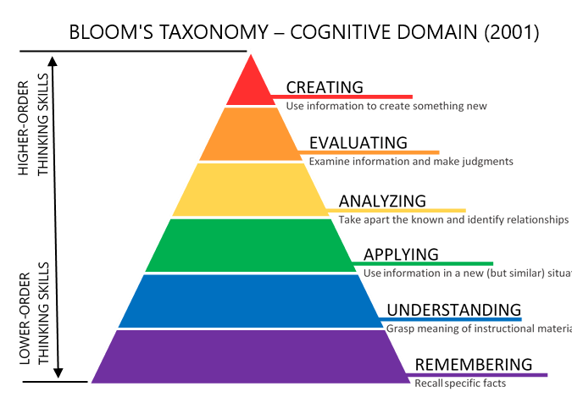
Program Objectives
Week 1: Remember, Understand, Apply
1
Week 2: Remember, Understand, Apply, Analyze
2
Week 3: Remember, Understand, Analyze, Evaluate, Create
3

Slide 7
Program Objectives: Week 1
Describe respective medical school curriculum, medical terminology, and key concepts through course-based instruction and practice.
Define metacognition and its importance in medical education.
Explain significance of time management and organization for academic success.
Gather information about learning, study practices, and attitudes from The Learning and Study Strategies Inventory to identify strengths, areas for improvement, learning preferences, and study habits.
Distinguish steps for goal-setting and self-reflection.
Explain the importance of self-care and stress management in medical school.
Explain the importance of building a support network for academic and emotional well-being in medical school, including growth mindset.

Slide 8
Program Objectives: Week 2
Recall and utilize the academic resources and support services provided for student success to optimize learning, retention, and understanding.
Advance knowledge in specific medical topics, such as Microbiology and Pathology.
Explain the significance of self-regulated learning (PBL)
Implement active learning techniques to comprehend complex medical concepts and breakdown medical problems/cases into manageable components.
Evaluation personal study habits and identify areas for improvement.
Evaluate the effectiveness of various time management strategies.
Notes:
Steph

Slide 9
Program Objectives: Week 3
Evaluate motivation for learning, willingness to use academic resources, and the effectiveness of current study practices through the LASSI and other formative assessments.
Evaluate comprehension of key concepts through formal assessment.
Assess relevance of active study skills in the context of medical training.
Develop a personalized academic plan incorporating effective study strategies.
Evaluate personal growth mindset tendencies and develop strategies to maintain growth mindset through medical school.

Slide 10

Program Development
Peer-to-peer
Curriculum
Rowan-virtua Community

Slide 11
Program Development: Curriculum
Collaboration
Phase One Curriculum Director
Schedule and changes
Course Directors
Curricular insights
Assessment
Faculty Presenters
Traditionally challenging content
Recommended resources
Evaluation
Osteopathic Clinical Skills
Canvas
Quizzes/Exams

Slide 12
Program Development: Curriculum
SGL
PBL
Breaking down lectures
Second pass consolidation
Deciphering learning objective
Practice questions as a learning tool
Traditionally challenging content
Resource selection
Using the syllabus
Pacing and planning
Incorporating practice questions
Self-testing

Slide 13
Program Development: Skill Sets
Pass system study method
  Time-driven environment
  Efficiency
Skills that facilitate understanding and support long-term retention
  Previewing
  Self-testing
  Spaced repetition practice
Time Management
  Tools for time organization
  Prioritizing
  Wellness considerations

Slide 14
Program Development: Skill Sets
Study Session Structure
  Pomodoro
  Goal-setting
Methods of Organization
  Extracting high yield information
  Charting/Tables
  Mind Maps
Self-Reflection
Problem-Solving

Slide 15
Program Development: Creating Community
Awareness
Access
Engagement

Slide 16
Creating Community
Exposure/Representation
Peer-to-Peer Model & Mentoring
Small Groups
Engagement Functions

Slide 17
Peer-to-Peer Model & Mentoring
Rising OMS-II students serves as Teaching Assistants (TAs) and mentors
  Approximately 20 students are hired:10 SGL & 10 PBL
  Applicants must have an overall pre-clerkship exam average of an 82
Driving force of the program
Responsible for the following:
  Developing and delivering curriculum content
  Breaking down curriculum content
  Teaching transferrable skills as related to curriculum content
  Facilitating small group discussions
  Provide group and 1:1 mentoring
  Creating and proctoring quizzes, exams, practical, and facilitator evaluations

Slide 18
Program Participation
Mandatory participation
  Application metrics
    Science GPA
    MCAT Score - Biology
    Other factors
Voluntary participation
  Alleviate anxiety
  Increased preparedness
    Academic
    Social

Slide 19
Program Evaluation
Learning and Study Strategies Inventory (LASSI)
  Identify strengths/weaknesses and apply interventions in low-stakes environment
  Students take the LASSI at the beginning and end of Pre-Matric and at the end of the fall semester
Final grades
  Determine additional levels of support for the fall semester
Notes:
Dyron

Slide 20
Data
PBL ​ |  |  | Pair t.​ | p value​
 | ​ | ​
 | mean​ | mean​
Anxiety​ | 65.12​ | 53.67​ | 3.275​ | 0.002​
Attitude​ | 71.30​ | 57.64​ | 5.67​ | <0.001​
Information Processing​ | 85.39​ | 69.48​ | 4.187​ | <0.001​
Concentration​ | 68.45​ | 50.94​ | 4.217​ | <0.001​
Select main Idea​ | 58.79​ | 39.45​ | 4.776​ | <0.001​
self-testing​ | 75.12​ | 61.55​ | 3.798​ | <0.001​
Time Management​ | 77.06​ | 63.91​ | 4.02​ | <0.001​
Using Academic Resources​ | 76.58​ | 58.33​ | 5.126​ | <0.001​
Lecture-based ​ | ​ | ​ | ​ | ​
Information Processing​ | 69.50​ | 56.08​ | 3.747​ | 0.002​
Select main Idea​ | 64.58​ | 51.67​ | 2.331​ | 0.04​
Test Strategies​ | 63.33​ | 71.46​ | -2.221​ | 0.04​
Note: only significant areas (α≤ 0.05) were shown. ​ |  | ​ | ​ | ​
Table 1. Improvement in LASSI Score Before and After Pre-Matriculation Program
(Wang, et al., 2024)

Slide 21
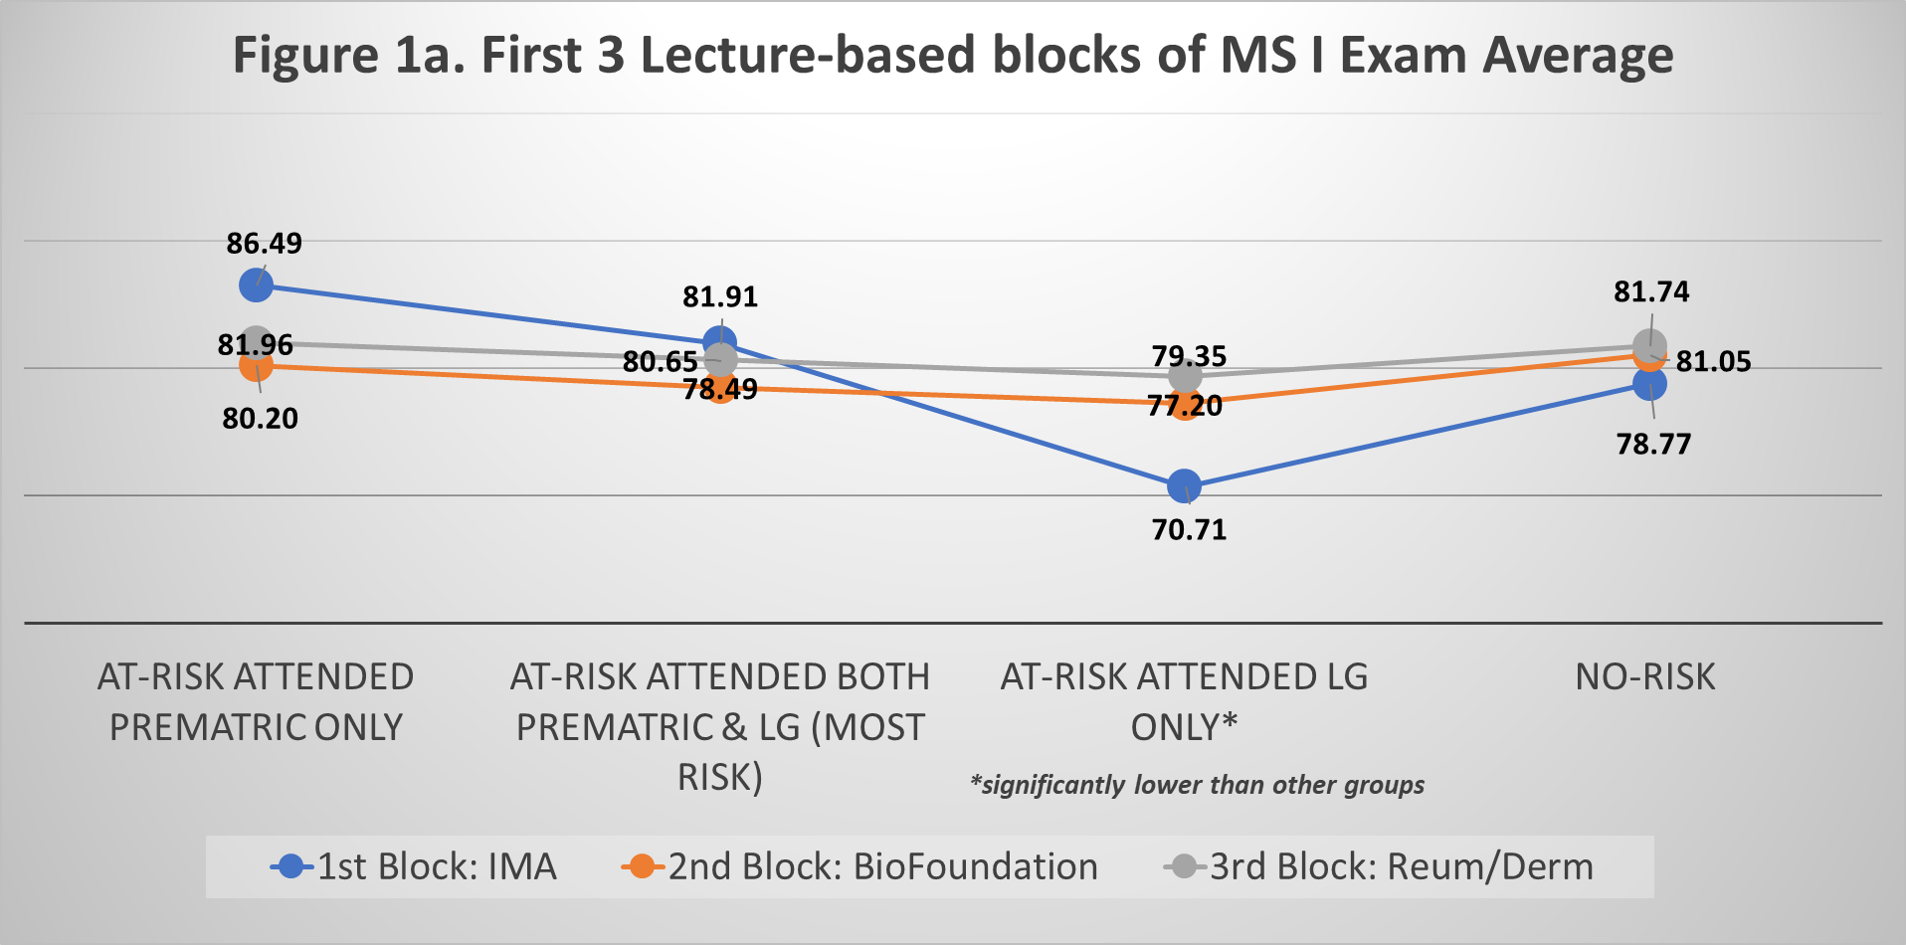

Slide 22
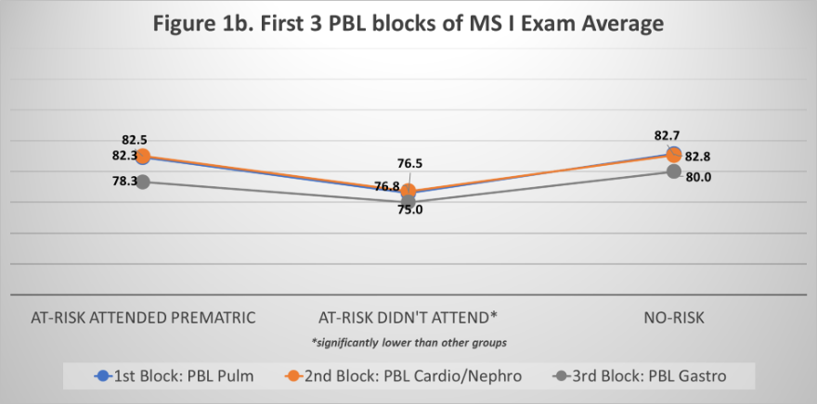

Slide 23
Insights
Incoming students
  High levels of anxiety
  Growth Mindset
  Separate self from outcome
  Faculty exposure
Program preparation
  High levels of coordination and collaboration

Slide 24
Insights
Less is more
  Space to practice/implement skills
  Increased peer interaction
  Designated opportunities to connect with TA’s
Content management
  Volume of traditionally challenging content vs. what is palatable
Examinations
Expanded TA training

Slide 25
Beyond Pre-Matriculation
Internal Tracking System
  Academic Monitoring
    Required participants with final grade below 80%
Targeted support
  2 meetings with CSS advisor
  Completion of Academic success plan
  Peer tutoring
  Guided Learning Groups (SGL only)
    Longitudinal relationships with TAs

Slide 26
Resources for Further Exploration
Developing a well‑received pre‑matriculation program: the evolution of MedFIT (Allen et al., 2022)
Transitioning to medical school: An innovative pre-matriculation program (Zhang et al., 2023)
A summer pre-matriculation program to help students succeed in medical school (Schneid et al., 2017)
Impact of pre-matriculation instruction on student acculturation and first-year academic performance in medical school (Hairrell et al., 2016)

Slide 27
Questions?

Slide 28
Stay in Touch
Stephanie Dearden
Dyron Corley
Email: dearden@rowan.edu
Email: corley20@rowan.edu

