Slide 1
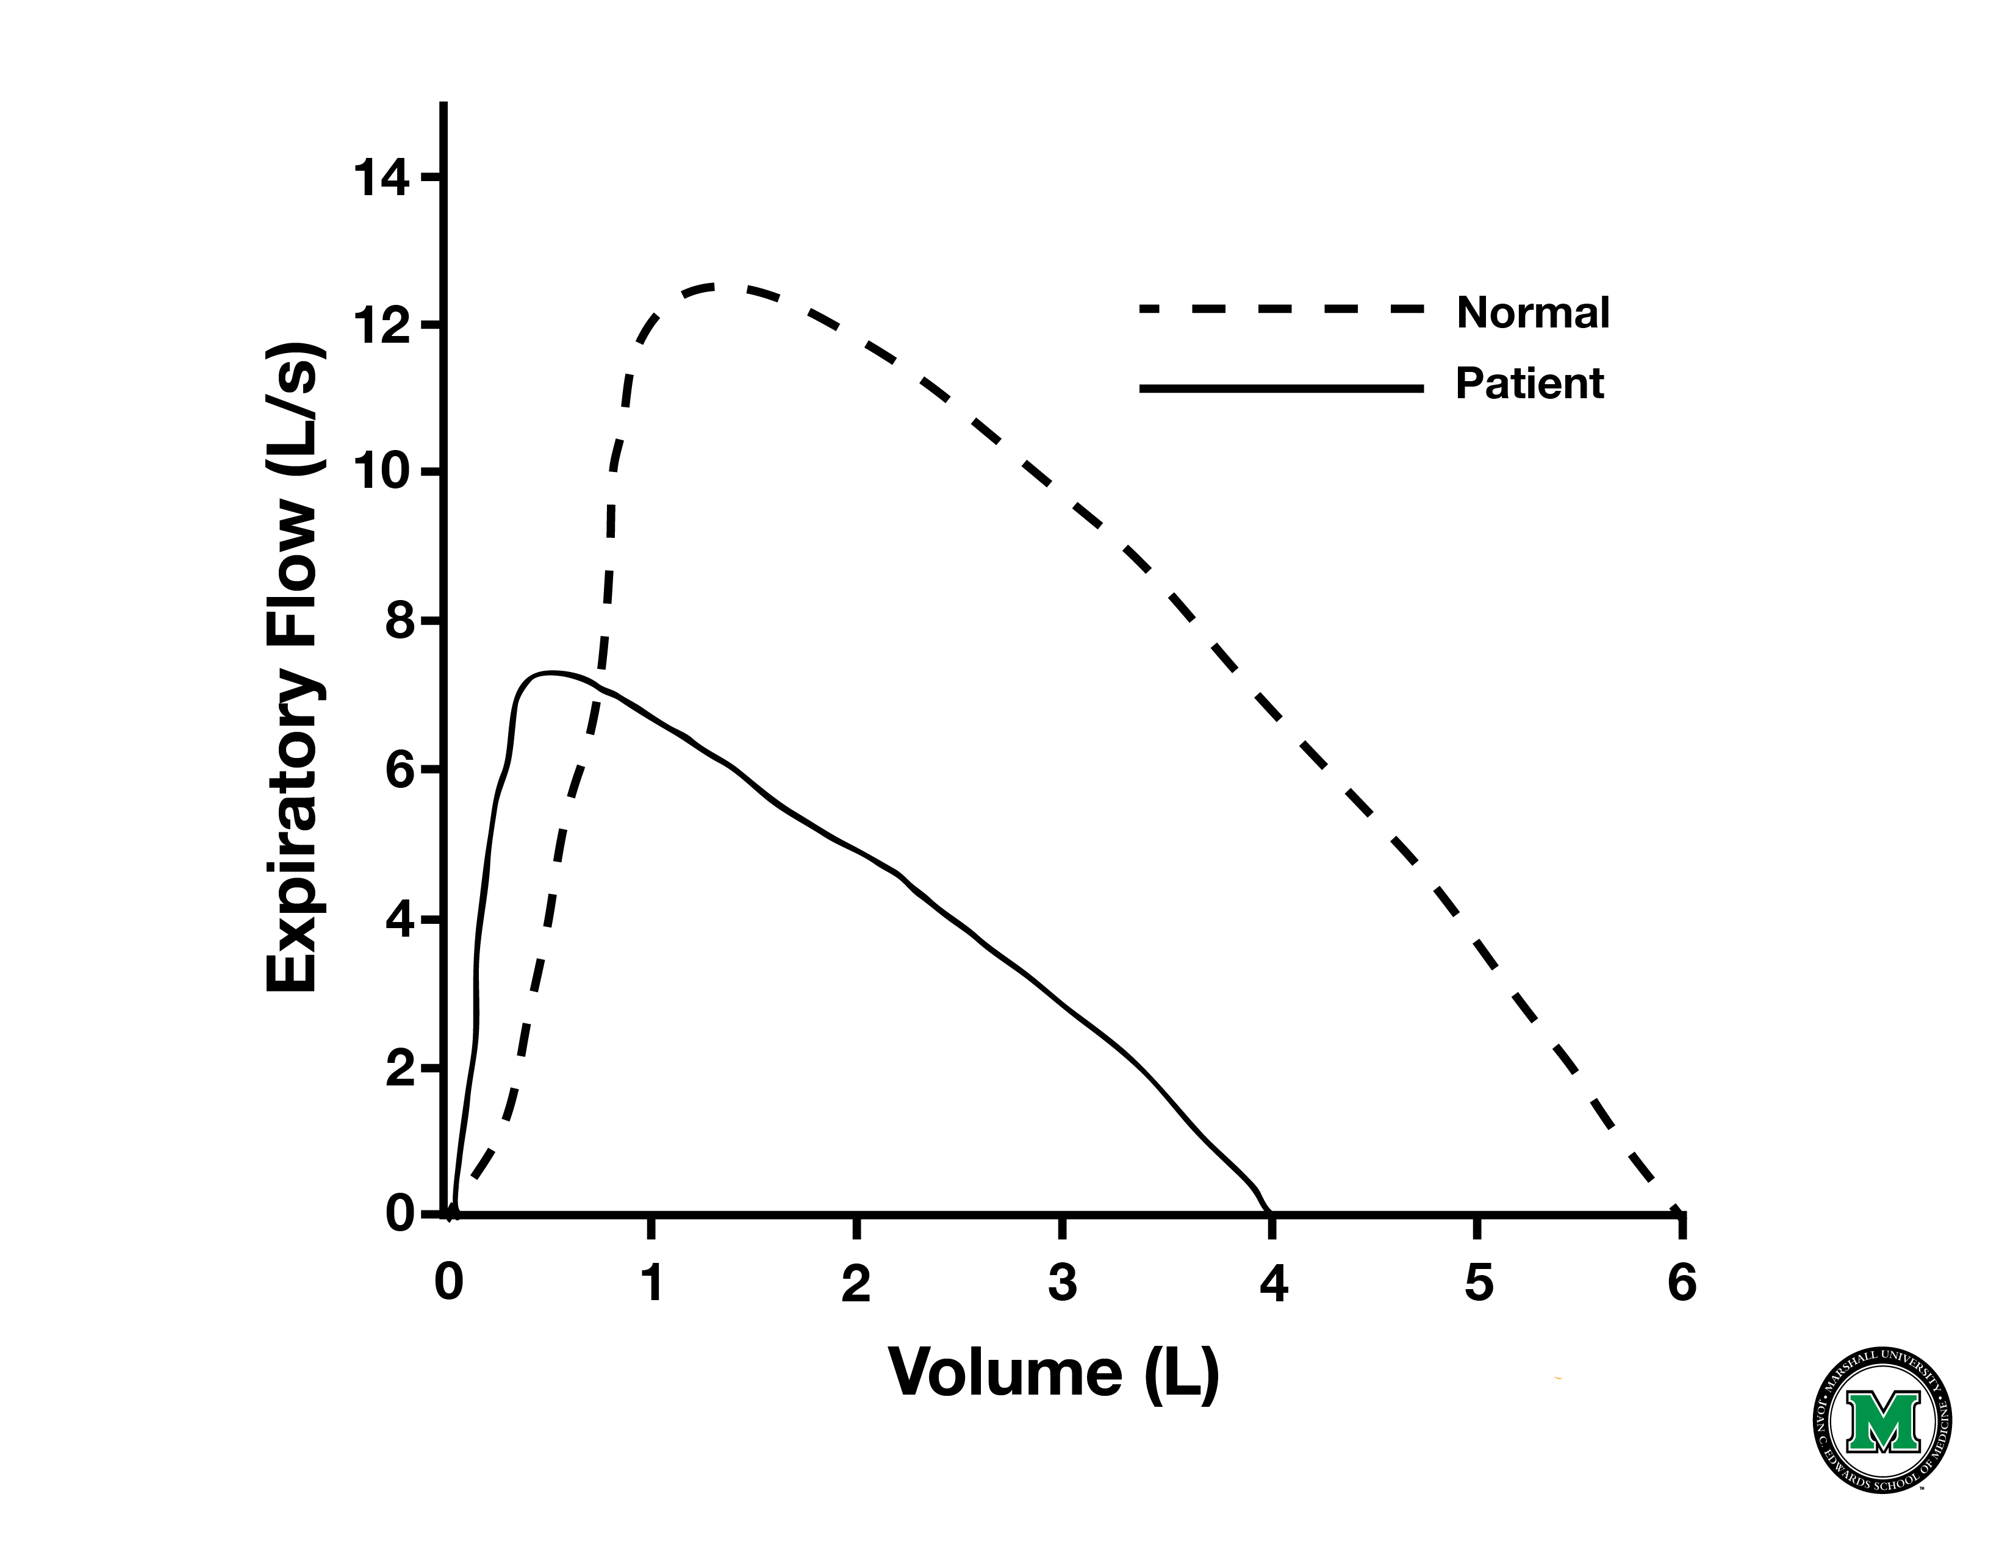
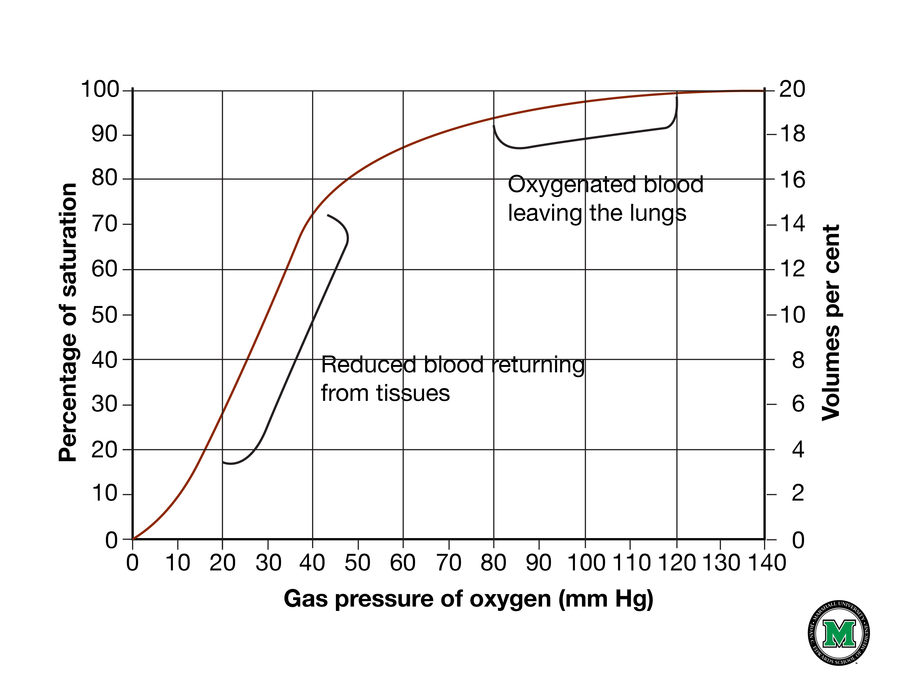
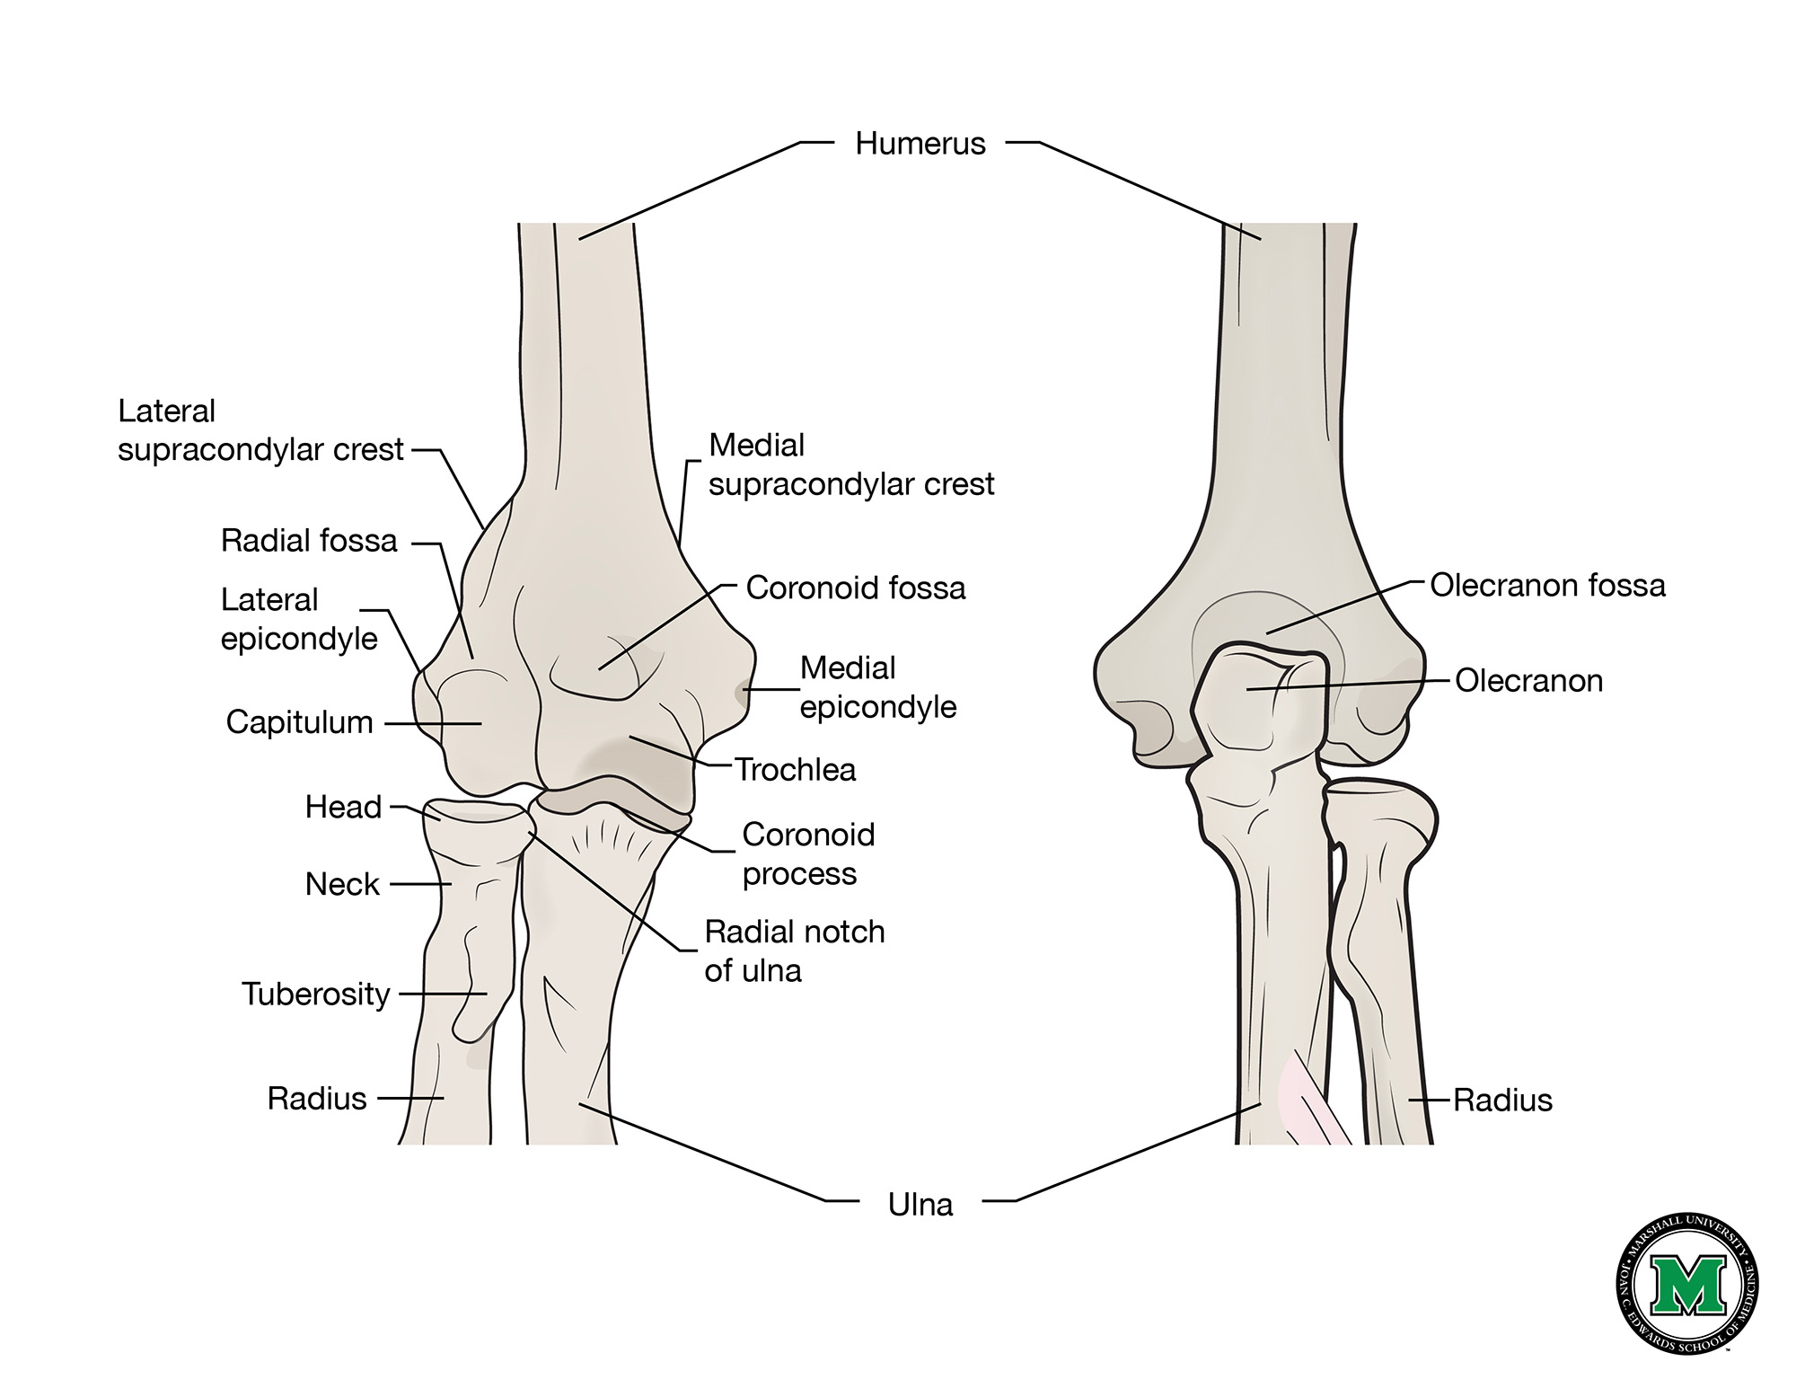
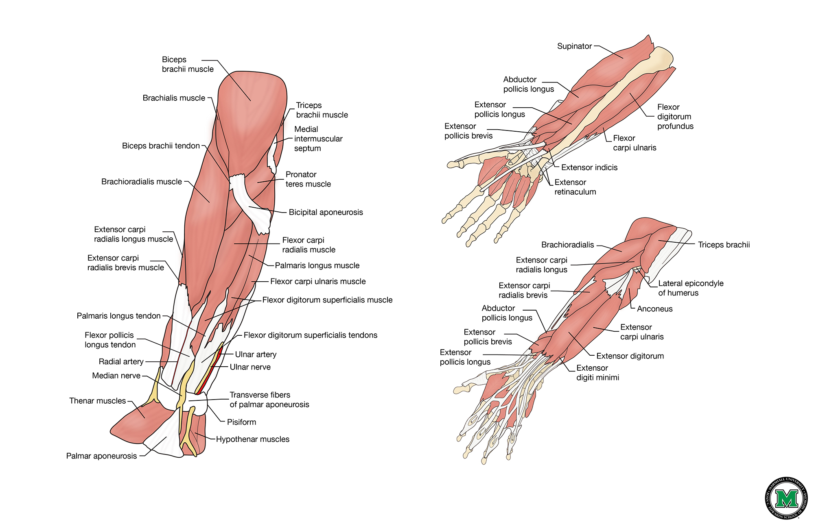
MUSOM RESEARCH DAY TEMPLATE
DR. SO AND SO M.D. // DR. SO AND SO 2 M.D. // DR. SO AND SO 3 M.D.
SOANDSO MEDICAL SCHOOL ACCREDITED FOR ALL KINDS OF THINGS
Title
Title
Title
JS VLJ sflsjnvlSnblkNSlkv slkdv nlsv lsnvlkanslvknaslhcmsiDHCosgcoUGCOsdgycosGOChgoichsDUGHCSIDGHOcshgoihmsDGIHmsidghmsiGHksuhgkusHMGDILchsmgdihsILDGHMcslidhgmlicsHMDGL
IhmdglihsLIGHsilhglicshGMlmishaodhmfgoiquahrgoicahmscoigcmhvSGHMACIHMVIAHGIHCIDVHTClkdnbkajnfbkjansfvonsVNlskvnlksVLslvsdLVNslvnclsDFCMlihf;SDCFNkluadcfnksDHFCshmdfkxhSMCDAMHCKJVMSKMCp’fF
JS VLJ sflsjnvlSnblkNSlkv slkdv nlsv lsnvlkanslvknaslhcmsiDHCosgcoUGCOsdgycosGOChgoichsDUGHCSIDGHOcshgoihmsDGIHmsidghmsiGHksuhgkusHMGDILchsmgdihsILDGHMcslidhgmlicsHMDGL
JS VLJ sflsjnvlSnblkNSlkv slkdv nlsv lsnvlkanslvknaslhcmsiDHCosgcoUGCOsdgycosGOChgoichsDUGHCSIDGHOcshgoihmsDGIHmsidghmsiGHksuhgkusHMGDILchsmgdihsILDGHMcslidhgmlicsHMDGL
IhmdglihsLIGHsilhglicshGMlmishaodhmfgoiquahrgoicahmscoigcmhvSGHMACIHMVIAHGIHCIDVHTClkdnbkajnfbkjansfvonsVNlskvnlksVLslvsdLVNslvnclsDFCMlihf;SDCFNkluadcfnksDHFCshmdfkxhSMCDAMHCKJVMSKMCp’fF
JS VLJ sflsjnvlSnblkNSlkv slkdv nlsv lsnvlkanslvknaslhcmsiDHCosgcoUGCOsdgycosGOChgoichsDUGHCSIDGHOcshgoihmsDGIHmsidghmsiGHksuhgkusHMGDILchsmgdihsILDGHMcslidhgmlicsHMDGL
IhmdglihsLIGHsilhglicshGMlmishaodhmfgoiquahrgoicahmscoigcmhvSGHMACIHMVIAHGIHCIDVHTClkdnbkajnfbkjansfvonsVNlskvnlksVLslvsdLVNslvnclsDFCMlihf;SDCFNkluadcfnksDHFCshmdfkxhSMCDAMHCKJVMSKMCp’fF
JS VLJ sflsjnvlSnblkNSlkv slkdv nlsv lsnvlkanslvknaslhcmsiDHCosgcoUGCOsdgycosGOChgoichsDUGHCSIDGHOcshgoihmsDGIHmsidghmsiGHksuhgkusHMGDILchsmgdihsILDGHMcslidhgmlicsHMDGL
Title: JS VLJ sflsjnvlSnblkNSlkv slkdv nlsvlsnvlkanslvknaslhcmsiDHCosgcoUGCOsdgycos
Title
JS VLJ sflsjnvlSnblkNSlkv slkdv nlsv lsnvlkanslvknaslhcmsiDHCosgcoUGCOsdgycosGOChgoichsDUGHCSIDGHOcshgoihmsDGIHmsidghmsiGHksuhgkusHMGDILchsmgdihsILDGHMcslidhgmlicsHMDGL
Title: JS VLJ sflsjnvlSnblkNSlkv slkdv nlsv lsnvlkanslvknaslhcmsiDHCosgcoUGCOsdgycos
Title: JS VLJ sflsjnvlSnblkNSlkv slkdv nlsv lsnvlkanslvknaslhcmsiDHCosgcoUGCOsdgycos

