Slide 1
Faculty Council Subcommittee on Retention and Recruitment and Compensation and Benefits
Report July 24th 2018

Slide 2
Subcommittee Members
Jim Denvir
Charles Meadows
Jared Brownfield
Deji Olajide
Todd Green

Slide 3
Outline of Report
Data sources
AAMC Standpoint Survey 2017
Internal Survey of Department Chairs Summer 2018
Progress
Discussion of future approaches

Slide 4
Standpoint Survey
Statements with standard Likert Scale responses
Strongly Agree / Very satisfied
Agree / Satisfied
Neither Agree/Satisfied nor Disagree/Dissatisfied
Disagree/Dissatisfied
Strongly Disagree / Very dissatisfied
Summary statistics combine strongly agree with agree, and combine strongly disagree with disagree
Large discrepancies in some questions between responses from clinical faculty and basic science faculty
This report will break out basic science response summaries

Slide 5
Standpoint Survey: Comparisons
For comparison, statistics available for entire cohort (33 schools) and four peer medical schools:
Florida International
University of Louisville
University of Missouri-Columbia
University of Nevada

Slide 6
Standpoint Survey: Compensation and Benefits
Five satisfaction/dissatisfaction questions:
My overall compensation
My incentive-based compensation, such as bonuses
Health benefits
Retirement benefits
My overall benefits package
Caveat:
Many basic science faculty have seen substantial improvements to their compensation package since the survey
Those improvements are not represented in these data

Slide 7
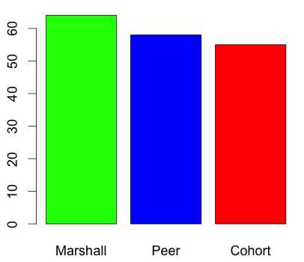
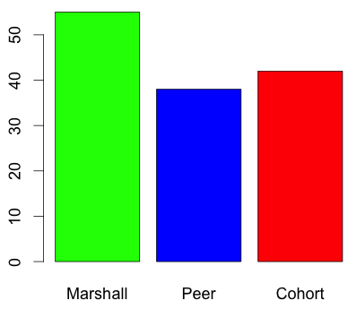
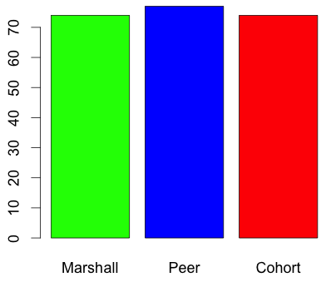
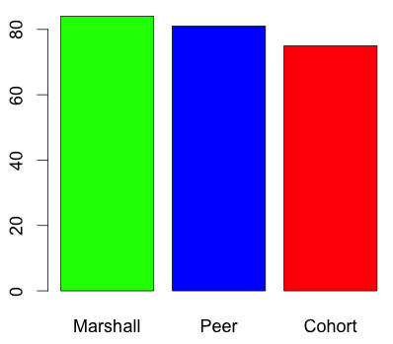
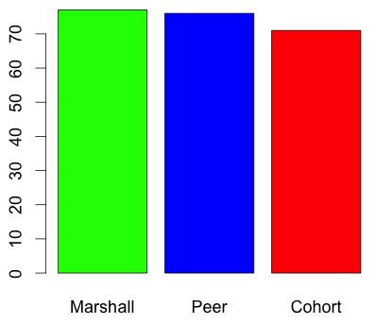
Compensation and Benefits: all faculty
Overall compensation
Health benefits
Overall benefits
Incentive
Retirement

Slide 8
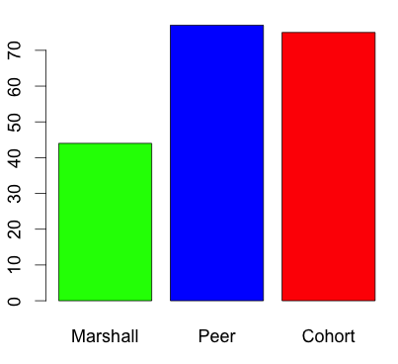
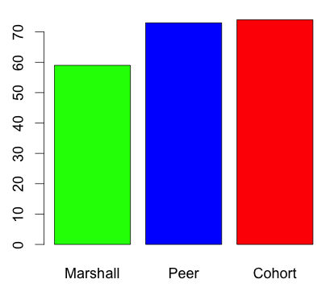
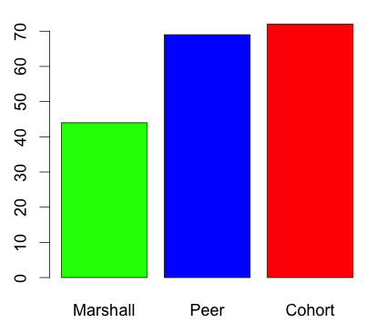
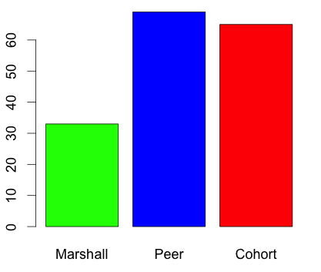
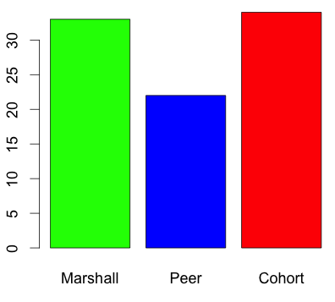
Compensation and Benefits: Basic Science
Overall compensation
Health benefits
Overall benefits
Incentive
Retirement

Slide 9
Compensation and benefits: Standpoint Survey
School-wide, satisfaction is similar to or better than peer and cohort
In basic science, satisfaction with all categories except incentive compensation trails peer and cohort by a substantial margin
Recent improvements to compensation package for one basic science department will likely have remedied the overall compensation category
Still need to ensure we do not end up back where we started in a few years
Health benefits are tied in to PEIA, which has been well-documented to have serious problems

Slide 10
Standpoint Survey: Recruitment and Retention
Four questions included in survey
My medical school is successful in hiring high quality faculty members
My department is successful in hiring high quality faculty members
My medical school is successful in retaining high quality faculty members
My department is successful in retaining high quality faculty members

Slide 11
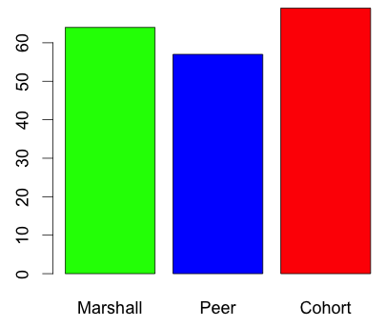
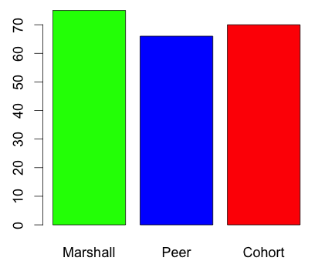
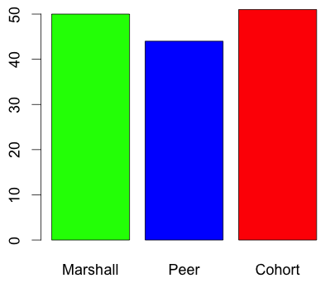
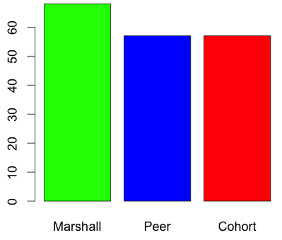
Recruitment and Retention: All faculty
Hiring SOM
Hiring Dept
Retaining SOM
Retaining Dept

Slide 12
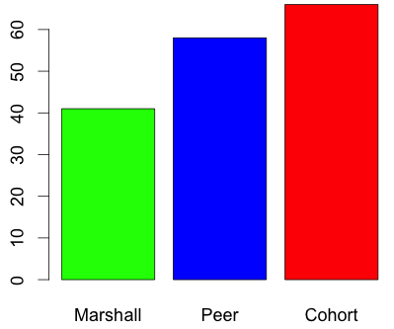
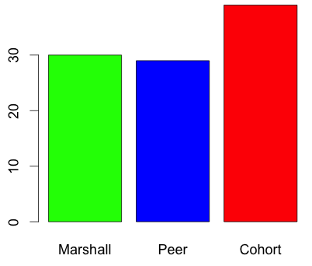
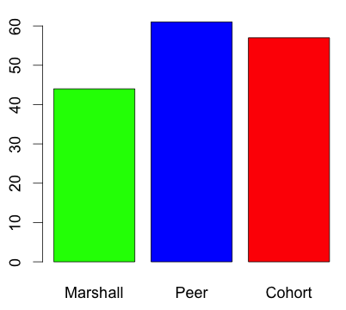
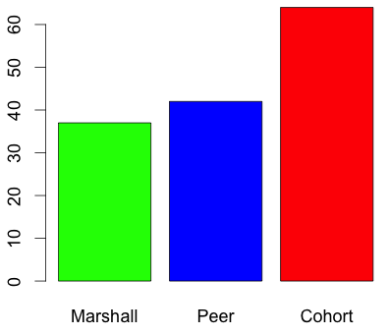
Recruitment and Retention: Basic Science
Hiring SOM
Hiring Dept
Retaining SOM
Retaining Dept

Slide 13
Recruitment and Retention Standpoint Survey
School-wide, faculty perception of recruitment and retention is comparable to peer schools and entire cohort
Among basic science faculty, recruitment and retention within the department is perceived as less successful than in peer schools and than in the entire cohort
Recruitment and retention within the entire school is perceived by basic scientists at MU similarly as it is among basic science faculty in peer institutions

Slide 14
Recruitment and Retention: Department Chair Surveys
Six open-ended questions concerning recruitment and retention presented in department chairs’ survey
12 of 16 department chairs completed the survey
10 responded to at least some recruitment and retention questions
What are your greatest challenges to recruitment?
What are your greatest challenges to retention?
Are there any strategies implemented by your department that have improved recruitment?
Are there any strategies implemented by your department that have improved retention?
What percentage of applicants to whom you make an offer accept it? (Estimate if necessary)
What percentage of faculty in your department have left for reasons other than retirement in the last five years?

Slide 15
Challenges to recruitment
Geography/location: 7/10
Department size: 4/10
Competition and/or national shortage of qualified applicants: 2/10
Salary: 1/10

Slide 16
Challenges to retention
Geography/location: 3/9
No issues: 3/9
Departmental size: 2/9
Salary: 2/9
Competition: 1/9

Slide 17
Strategies for recruitment
None/no improvement: 3/9
Improving compensation: 3/9
Yes (no specifics): 2/9
Clinical autonomy: 1/9
Build practice: 1/9
“We have been successful in recruiting quality faculty for many years. Lifestyle balance, teaching opportunities, improved compensation all help.” 1/9

Slide 18
Strategies for retention
None/none successful: 4/9
Yes (no specifics): 2/9
Incentives/compensation: 2/9
Clinical autonomy: 1/9
“We have been successful in recruiting quality faculty for many years. Lifestyle balance, teaching opportunities, improved compensation all help.” 1/9

Slide 19
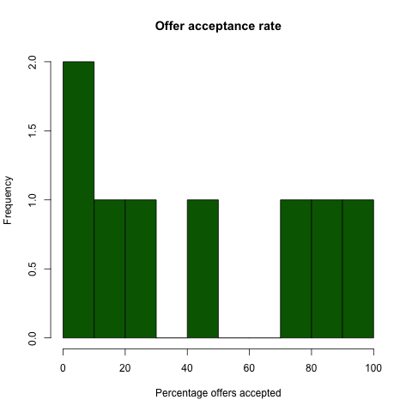
Percent offers accepted
Note: one chair reported 3%, which seems unlikely.

Slide 20
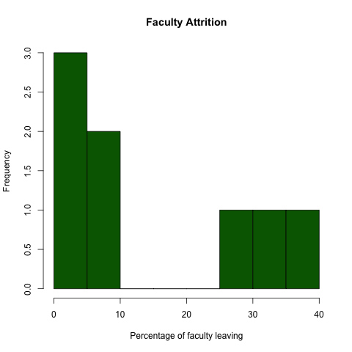
Percent faculty leaving

Slide 21
Discussion items: compensation and benefits
Basic science faculty salaries had fallen substantially behind competitive levels at the time of the standpoint survey
This has now been remedied for BMS
Recommend establishing policies that avoid salaries falling behind again
BMS currently has a committee working on this
High level of dissatisfaction among basic science faculty with health benefits
Not sure there is anything we can do directly here, as we are tied in to PEIA

Slide 22
Discussion items: Recruitment and Retention
Majority of chairs responding identified rural location and/or Huntington as an impediment to recruitment
May be useful to establish strategies for “selling” the city to interview candidates
Could liaise with community groups
Chamber of commerce, Create Huntington group, #MyHuntington, HMOA, local festival organizers, etc.
Would be useful to track reasons for faculty leaving
Conduct formal exit interviews, track data
May also be useful to survey current faculty for reasons for staying
Faculty perception of retention is perhaps worse than the reality of the number of faculty leaving

Slide 23
Questions/Comments

