Slide 1
CV and Personal Statement WOrkshop
October 30, 2019

Slide 2
The personal statement
Intro paragraph: introduce yourself and provide a thesis/theme for your statement
Body paragraph(s): support thesis/theme by highlighting academic skills/relevant experiences
Final paragraph: indicate why you are applying to a specific school/program.

Slide 3
What TO DO IN A PERSONAL STATEMENT
Hook the reader with a relevant and interesting opening statement.
Show, don’t tell – and then evaluate your experiences (don’t just describe them).
Include a thesis or theme for the sake of cohesion.
Utilize concise but inviting language.
Remain positive.
Be yourself, rather than an idealized “you.”
Elaborate upon important features of your CV/resume.
Seriously reflect upon and address past failures in a succinct but satisfying manner.
Research the program where you are applying.
Abide by word/page limits (typically, keep it at or under two single-spaced pages).

Slide 4
What NOT TO DO IN A PERSONAL STATEMENT
Hook the reader with a lengthy anecdote (or mistake the genre for an opportunity to craft a creative writing narrative).
Apologize for or “explain away” past failures.
Complain about previous work/academic experiences/life experiences.
Preach.
Discuss money as a motivator.
Include empty flattery of the program that you are applying to.
Utilize cliches.
Include wordy descriptions.
Employ big words for the sake of showcasing intelligence.

Slide 5
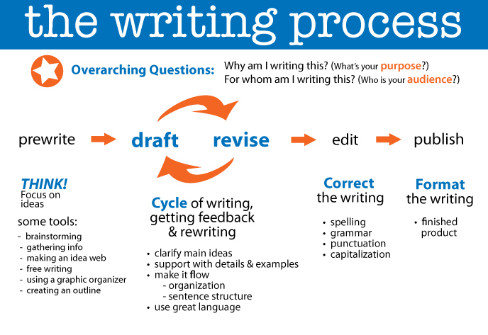
Tips for Composing Any Document
Remember that writing is a process
Global issues
Local issues
From https://collegeunbounddemo.wordpress.com/2012/09/05/the-writing-process/

Slide 6
Freewrite
Here’s a list of common questions that could be addressed in a personal statement. Take the next10 minutes to freewrite about your responses to these questions:
Tell me about your strengths.
Have you ever had to overcome any hardships or difficulties that led to your decision to study medicine?
What experiences influenced your decision to become a doctor, and why?
Where would you like to be in your career five years from now?
Why would a patient want you as his or her physician?

Slide 7
Reflect
Review your freewrite. What do you think the thesis/theme of your personal statement is based upon your responses? Which pieces of support would you use for that thesis/theme? Underline or highlight those pieces of support in the freewrite.
Pair up with 2-3 peers to discuss your thesis/theme and support for your personal statement.

Slide 8
What to include in your CV
Your CV should include the following elements:
Personal information (name, address, phone number, professional email address)
Education (include all higher education from most recent to least recent)
Relevant Honors and Awards
Relevant Employment Experience
Relevant Extracurricular Activities
Publications/Presentations
Personal and Professional Interests
References
Adapted from AAFP’s Strolling Through the Match 2019

Slide 9
Sample CV
From https://www.aafp.org/dam/AAFP/documents/medical_education_residency/the_match/strolling-match.pdf

Slide 10
The writing center
Where: Drinko Library, 2nd floor and http://marshall.mywconline.com
When: Monday-Friday, 9 am to 4 pm, with additional online hours 7 to 9 pm.

Slide 11
Appointment types
In Person: Students meet in person with a tutor at the Writing Center. You should be able to access your paper/writing materials via a WC computer/flashdrive, personal laptop, or by bringing a hardcopy with you.
Blue appointment
Online: Students meet with their tutor in an online WC chatroom. You will talk to your tutor in real time, and have the option to upload your documents so both parties can view/edit them simultaneously.
Red appointment
eTutoring: Students upload their documents when they make their appointment, and tutors have 24 hours from the time of the appointment to provide feedback. This will usually be in the form of in-text comments on the word document.
Green appointment

Slide 12
Questions?
Contact:
Anna Rollins, Director of the Writing Center, writing@marshall.edu
http://marshall.mywconline.com
www.marshall.edu/writingcenter

